Slide 1


Annual Trip Reduction Survey
September 10th 2024

Slide 2
TDM Program Requirements
City Ordinance requires participation by all employers with 25+ employees
Employers must reduce peak period automobile travel by 38%
Burbank Transportation Management Organization
  Non-profit, assists employers to meet trip reduction goals
Annual Commute Survey
Notes:
The Burbank TDM ordinances require participation by all employers with 25 or more employees in the Media District and in Downtown Burbank.
Employers are required to reduce their peak period automobile travel by 38%.
The ordinance also created the Burbank Transportation Management Organization. This is the non-profit that brought all of us here together today.
Finally, the ordinance requires that all covered employers submit an annual commute survey. The survey allows the City and the TMO to track commute patterns and see which employers are meeting their congestion mitigation goals.

Slide 3

Why Survey?
Surveys are essential for tracking progress, understanding Burbank's transportation needs, and fulfilling important reporting requirements, all of which contribute to a healthier and more sustainable community.
Notes:
By tracking progress, employers can see how well their trip reduction efforts are working year over year, giving them the data needed to adjust or improve their programs.
Understanding Burbank's transportation needs allows the city and businesses to identify patterns, challenges, and opportunities—like whether employees need better public transit options, more incentives for carpooling, or support for biking and walking.
This, in turn, supports fulfilling reporting requirements that the city mandates, ensuring compliance with local regulations and contributing to the region’s long-term sustainability goals.
Ultimately, the data gathered helps Burbank build a healthier, more sustainable community by reducing congestion, improving air quality, and promoting greener commuting habits.

Slide 4
Annual Survey & Reports
Submit annual reports to the Burbank TMO
Survey week: September 23-27, 2024
  One week: Monday – Friday
  Every employee
  Survey Collection Begins September 30th
  Peak period: 4 pm – 6pm
    Outside of peak period?
      Count towards survey received, but no vehicle or employee trip
    This includes telecommuters!
Notes:
The annual survey must be submitted to the Burbank TMO. The survey week is typically the first full week in May, though this year it has been moved to September. Every employee is surveyed for the peak period of 4-6 pm. This is for employees who are either leaving or arriving at work during those times.
You still need to survey those who commute outside of the peak period. They will count towards a survey received but will not count as a vehicle or employee trip.
And I have to mention that telecommuters need to be surveyed! They’re working, and even though their commute may be from a bedroom to an office, this is still meaningful information to both the TMO and the City, so you 100% need to survey your telecommuters.
If you submit an AQMD survey, you can use your AQMD survey week instead. Please contact the TMO and request an extension on the due date.
We have two survey options to talk to you about today. The first is the TMO employee survey and annual trip reduction tool, which many of you might already be familiar with.
The second is one that our larger employers might know and love, the LA Metro AVR survey tool.

Slide 5
Annual Survey & Reports
Survey Options
  TMO Employee Survey and Annual Trip Reduction Report (paper)
  LA Metro AVR Survey Tool (Online)
Recommended Method!
Notes:
The annual survey must be submitted to the Burbank TMO. The survey week is typically the first full week in May, though this year it has been moved to September. Every employee is surveyed for the peak period of 4-6 pm. This is for employees who are either leaving or arriving at work during those times.
You still need to survey those who commute outside of the peak period. They will count towards a survey received but will not count as a vehicle or employee trip.
And I have to mention that telecommuters need to be surveyed! They’re working, and even though their commute may be from a bedroom to an office, this is still meaningful information to both the TMO and the City, so you 100% need to survey your telecommuters.
If you submit an AQMD survey, you can use your AQMD survey week instead. Please contact the TMO and request an extension on the due date.
We have two survey options to talk to you about today. The first is the TMO employee survey and annual trip reduction tool, which many of you might already be familiar with.
The second is one that our larger employers might know and love, the LA Metro AVR survey tool.

Slide 6
Recommended Steps
Decide whether you would like to use the paper forms (English form (pdf, word) and Spanish form (pdf, word)) or reach out to Tiffany to set up an online survey link.
Distribute paper surveys or the online link to your employees anytime on or after the Friday of the survey week. Here’s a sample cover page/email and flyer that you can use. The survey should go to each employee who arrived or departed between the peak hour (4-6pm) at least once during the week. This includes telecommuters!
Set a deadline for your employees to return the surveys and designate who the surveys should be returned to in order to help ensure a high response rate.
Tabulate your results and complete the Report (Form B) using the Worksheet and Report tables. View the Instructions tab for more details.
Email the Report of your survey data/results to Destree Lazo Bascos at director@btmo.org or mail it to the BTMO at 200 W. Magnolia Blvd., Burbank, CA 91502.
Notes:
The annual survey must be submitted to the Burbank TMO. The survey week is typically the first full week in May, though this year it has been moved to September. Every employee is surveyed for the peak period of 4-6 pm. This is for employees who are either leaving or arriving at work during those times.
You still need to survey those who commute outside of the peak period. They will count towards a survey received but will not count as a vehicle or employee trip.
And I have to mention that telecommuters need to be surveyed! They’re working, and even though their commute may be from a bedroom to an office, this is still meaningful information to both the TMO and the City, so you 100% need to survey your telecommuters.
If you submit an AQMD survey, you can use your AQMD survey week instead. Please contact the TMO and request an extension on the due date.
We have two survey options to talk to you about today. The first is the TMO employee survey and annual trip reduction tool, which many of you might already be familiar with.
The second is one that our larger employers might know and love, the LA Metro AVR survey tool.

Slide 7
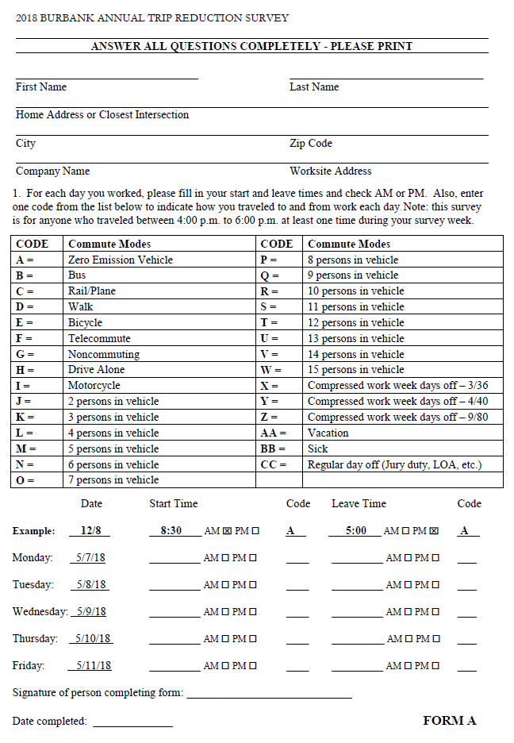
Option 1: TMO Trip Reduction Report
Notes:
This is the TMO’s trip reduction survey form.

Slide 8
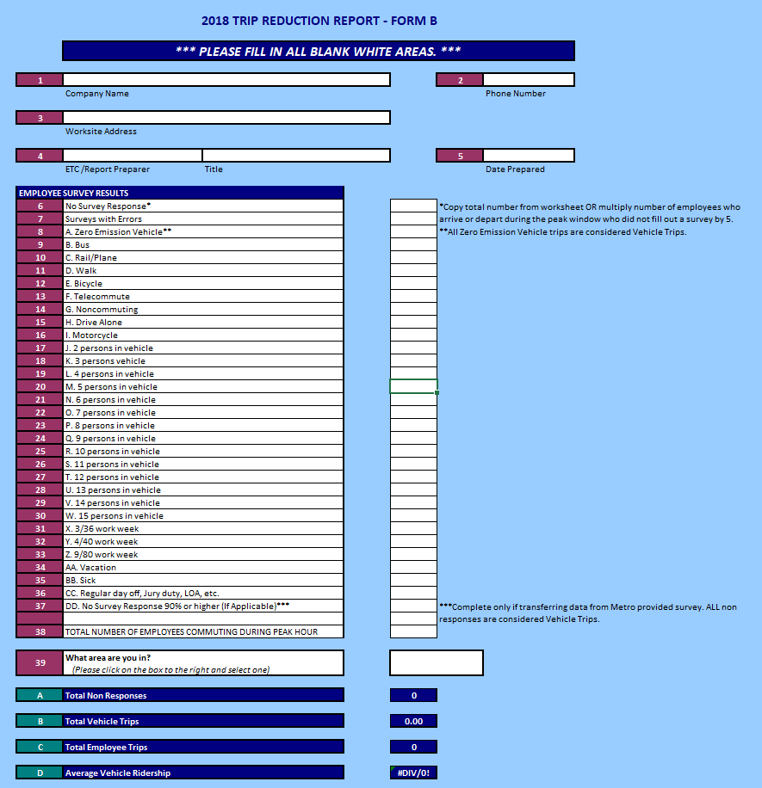
Notes:
And this is the AVR calculation excel file, as shown in part here.

Slide 9
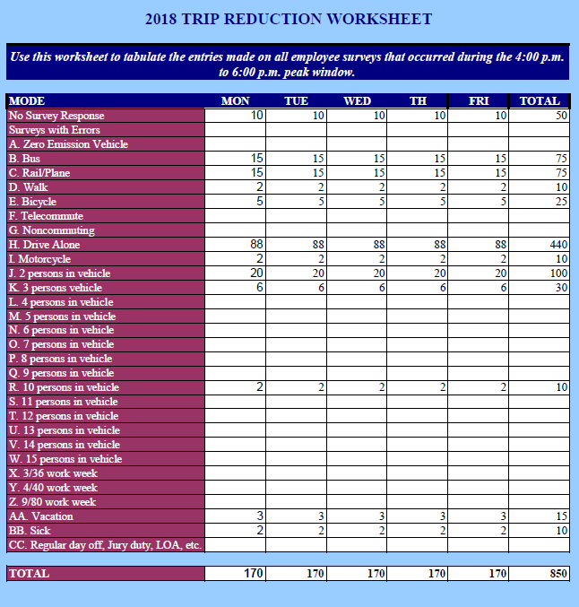
Notes:
The excel file has a worksheet that let’s you tally up all of the trips. It’s called “Worksheet.” This helps ease the calculations needed to be done for the worksheet on the previous slide.

Slide 10

Metro Commuter Options
& Regulatory Compliance Support – Countywide Planning

Slide 11
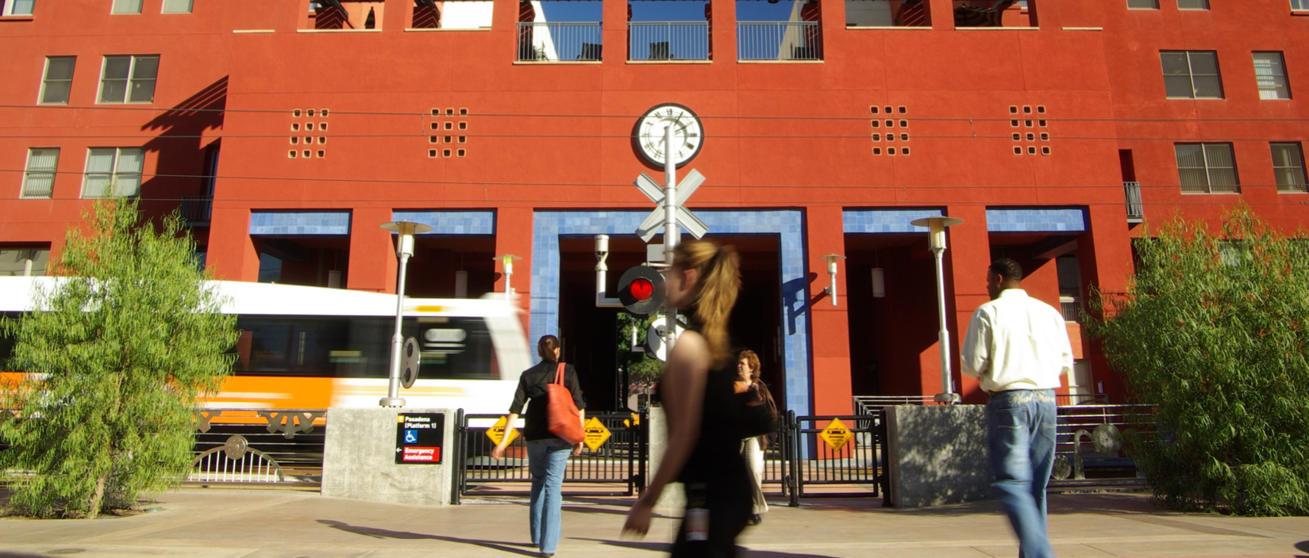
SCAQMD Rule 2202 & City Ordinance
AVR Survey Processing & Calculation
(No cost Employers)
Online Ridematching
(www.ridematch.info)
Personalized RideGuides
(100% Electronic)

Slide 12
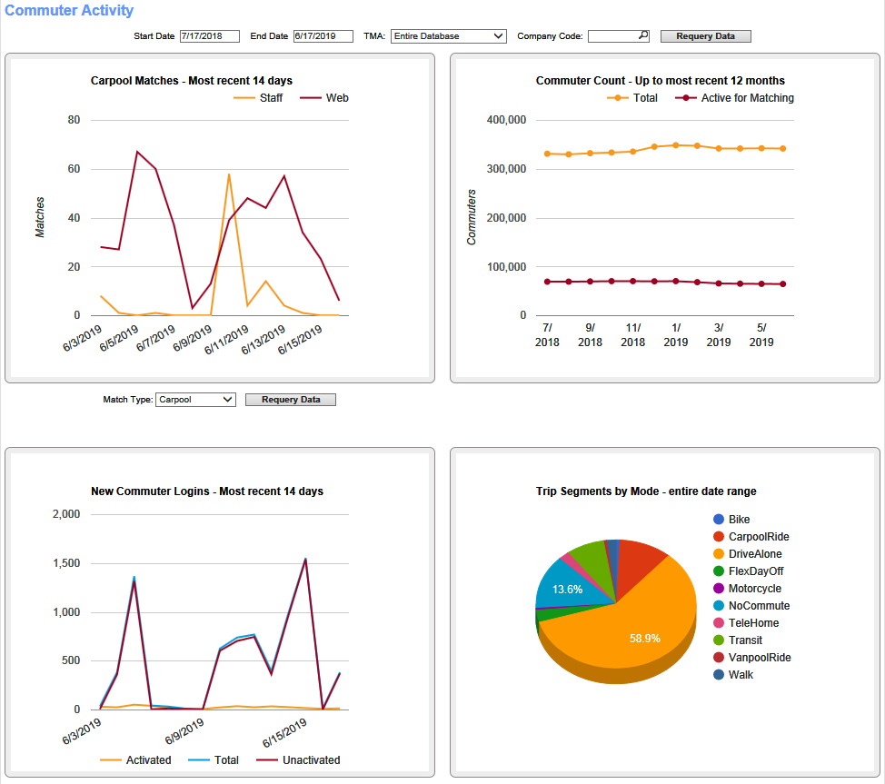
ETC Portal On-Line Access
Standard Dashboards
Provides a graphical view of commuter activity
Optional views available from the drop-down menus

Slide 13
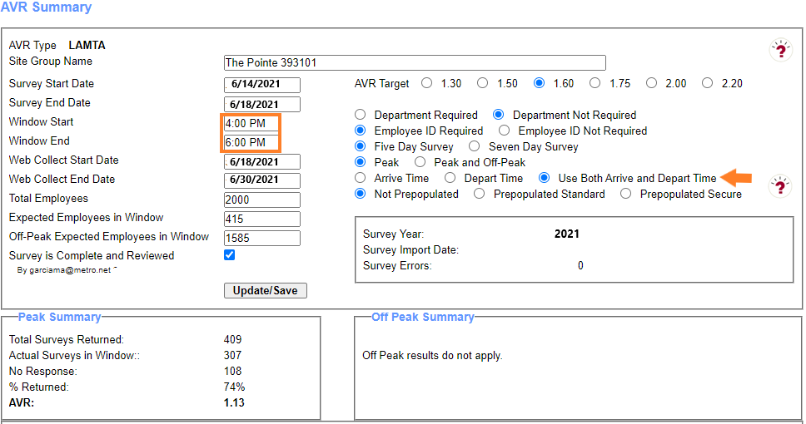
City of Burbank Ordinance
AVR results are compiled only for those employees that arrive and/or depart between 4-6PM
Employers with 25 or more employees in the Downtown Burbank and Media Districts are required to reduce the number of employee vehicular trips that their businesses
Monitor Your Real-Time AVR and Response Rate During Survey Process

Slide 14
AVR Calculations No Cost to Employers
Four (4) AVR survey options for employers:
Electronic/Online
Paper
Combination

Slide 15
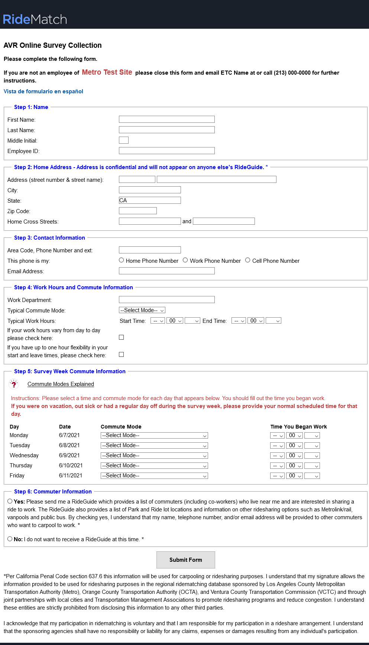
Electronic/Online
You will be sent an online link and QR code to send to your employees.
The survey is accessible in both English and Spanish
All required fields must be completed to submit the survey
Arrival & Departure times are required even for days off.

Slide 16
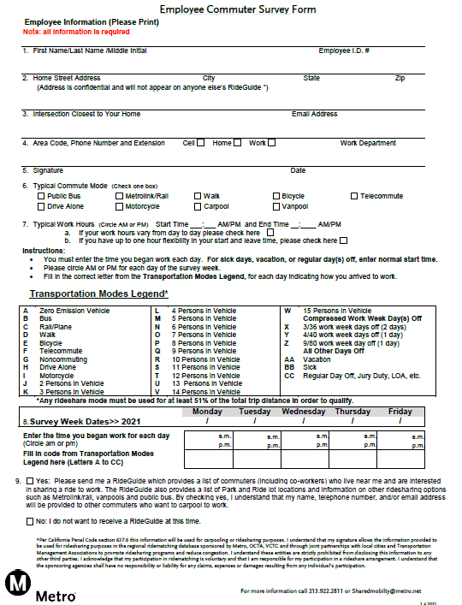
Paper Survey
If you use paper surveys, you will need to enter them in the system for automated calculation.
Forms must be signed by the employee.
Forms should be kept on file for 3 yrs after the survey period

Slide 17
Electronic/Online Required Fields
Step 1: Name
First Name, Last Name, Employee ID
Step 2: Home Address
Street Number, City, and Zip code or
Major cross streets, City, and Zip code
Step 3: Contact Information (Provide at least one)
Area code, Phone Number, and Email Address
Step 4: Work Hours and Commute Information
Typical Commute Mode, and Typical Work Hours
Step 5: Survey Form (Entire section must be completed)
Step 6: Commuter Information
Place a checkmark, Yes please send me a RideGuide
Place a checkmark, No I do not want to receive a RideGuide

Slide 18
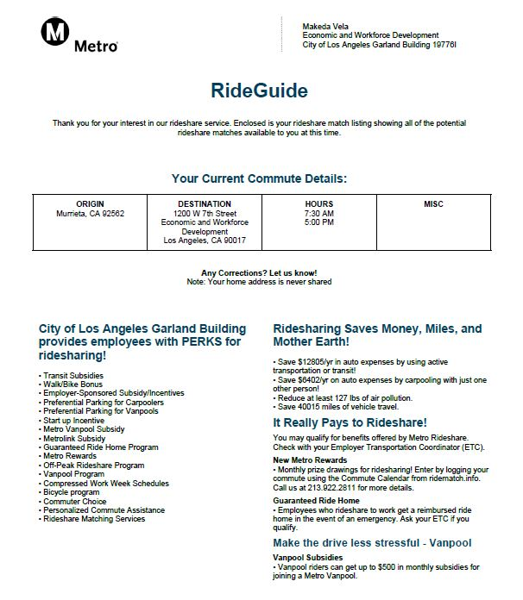
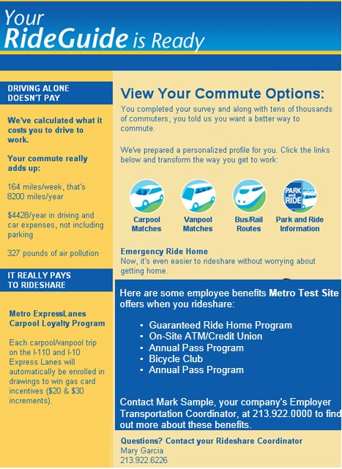
Say “YES” to a RideGuide
RideGuides may include potential carpool partners, vanpools, bus/rail routing, Park & Ride lot information and more.
To receive a RideGuide, employees must check “yes”
All employees that say “yes” to the RideGuide are entered into a monthly drawing for a $25 gift card. Flyer will be sent with the survey link and QR code.
Employees that want a RideGuide should fill the survey out in its entirety to find the best possible matches.
Personal information such as home address is never shared with others.

Slide 19
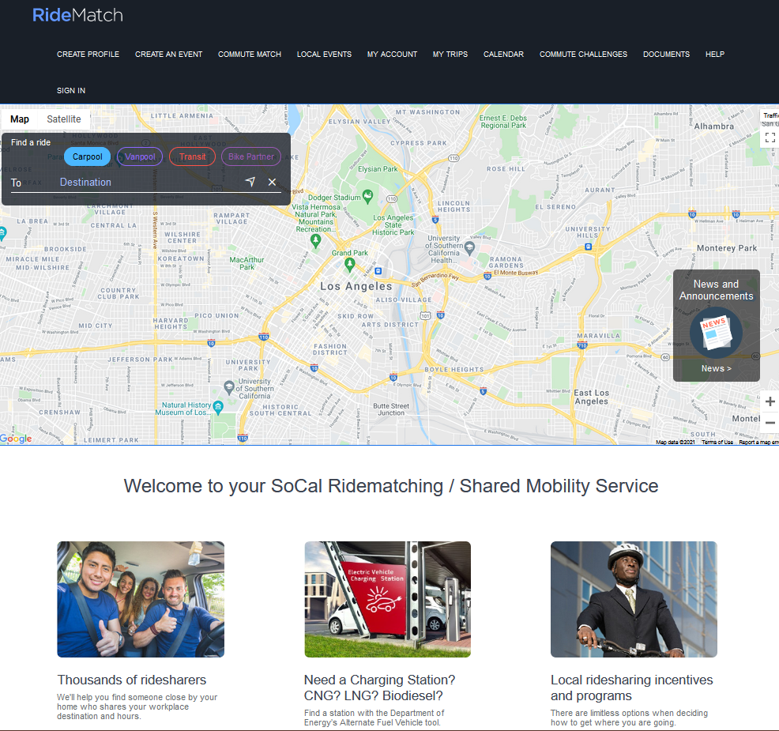
Ridematch.info Website
  Find carpool, vanpool, and bike partners
  Find transit routes and Park & Ride lots
  Match only with co-workers or other local employers
  Printing “RideGuide” is an option
  Find locations for Alternate Fuel and EV Charging Stations

Slide 20
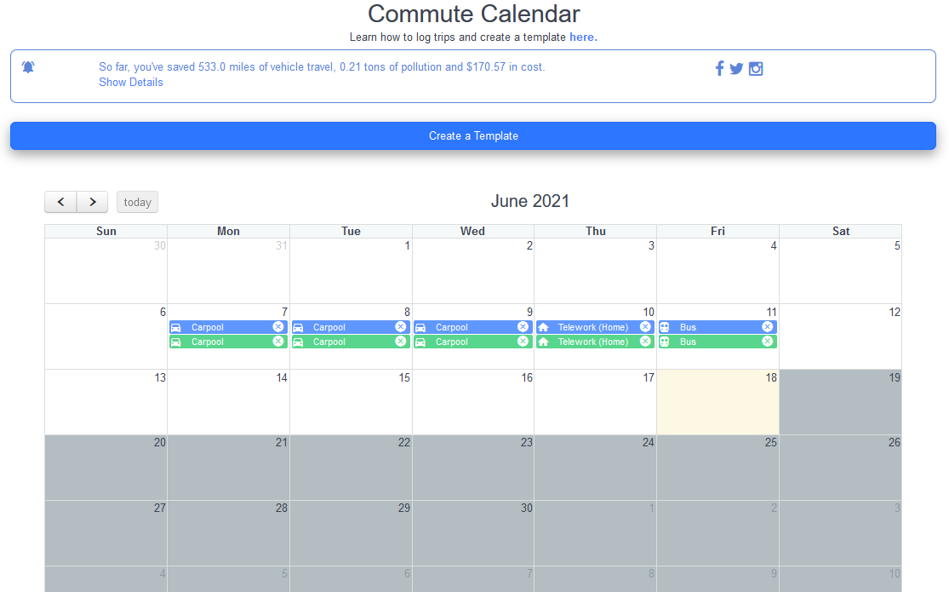


Metro Incentive Programs
Metro Rewards
Provides monthly prize drawings for employees who register and track their commute trips online at ridematch.info via computer or mobile device
Go Metro to Work Free
Provides a free 7-Day Metro TAP card, a $25 value, to newly hired employees at participating worksites

Slide 21
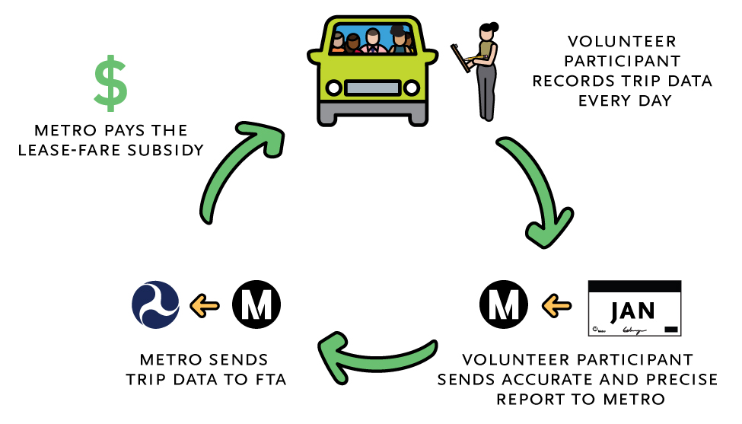
Metro Vanpool
Metro Vanpool provides up to $600 monthly lease subsidy towards the lease of vehicle.
Available to vanpools terminating their trip at a worksite in Los Angeles County
VOLUNTEER PARTICIPANT
COMPLETES AND SUBMITS
THE MONTHLY REPORTS ONLINE

Slide 22
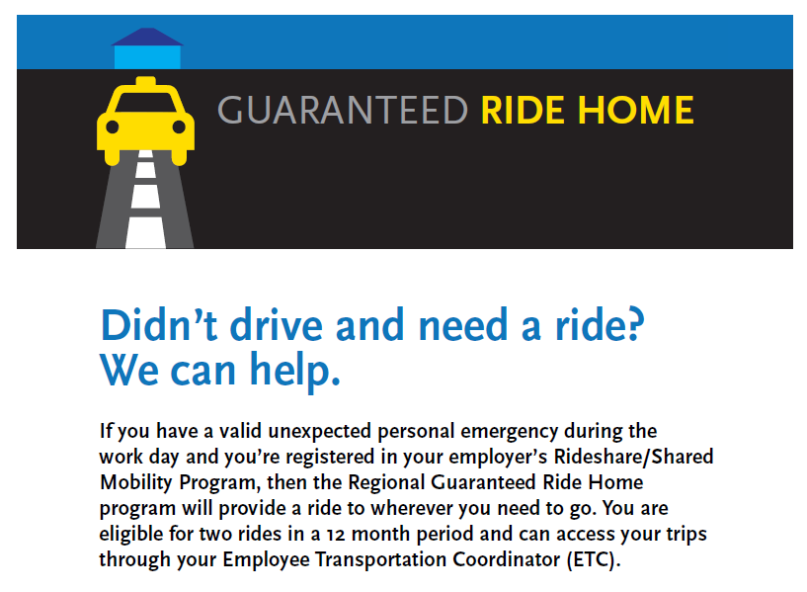
Regional Guaranteed Ride Home Program

Slide 23
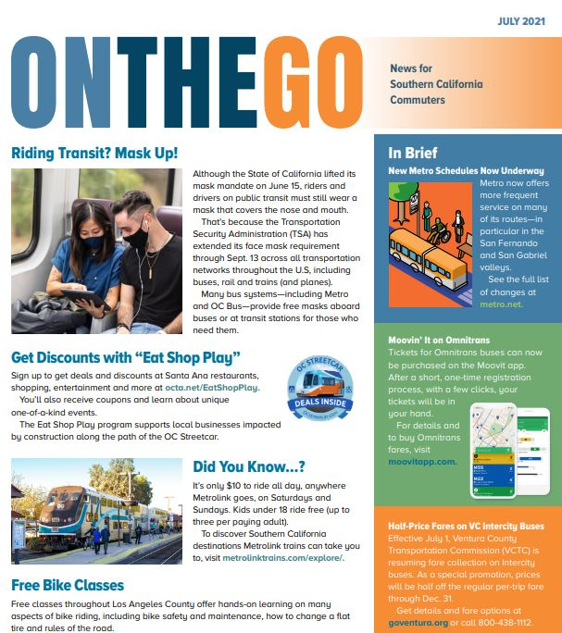
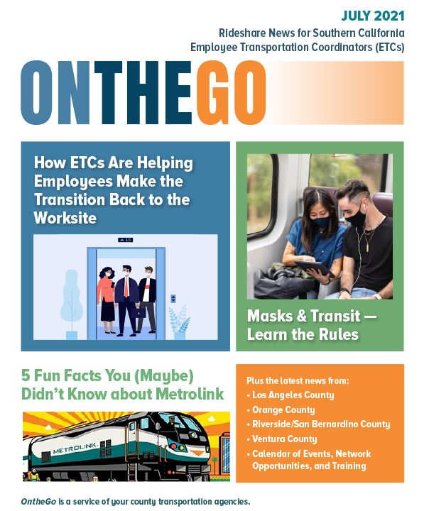
On the Go Newsletter
ETC Newsletter and Commuter Newsletter

Slide 24
QUESTIONS?
Tiffany Fischer
fischert@metro.net
(213) 922-4233
Commuter Options
commuteroptions@metro.net
(213) 922-2811

Slide 25
Contact the BTMO at:
(213) 425-0976
zoe@btmo.org
Learn more at:
https://btmo.org/survey-support/
Follow us on:
@TheBTMO on Facebook, Instagram, and Twitter
Questions?

Slide 26
LA Metro Survey Tool
LA Metro provides online survey tool
Tool is free!
Easy to use
  Automatically calculates AVR for both AQMD and Burbank survey needs
  Allows for paper surveys as well
  Simplified survey tracking
Notes:
LA Metro also provides an online survey tool for completing your survey.
It’s free
It’s easy to use
It automatically calculates AVR for both AQMD and Burbank’s survey needs. It allows you to integrate paper surveys into your survey process as well.
It also simplifies survey tracking – for those of you with lots of employees this is crucial.
I use it for the City’s AQMD and TMO survey and I can’t recommend it enough.

Slide 27
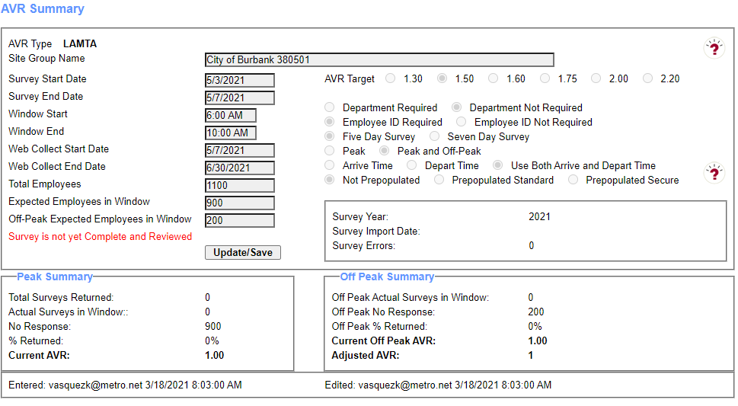
LA Metro Survey Tool
Notes:
You have an online dashboard that shows you the number of people who have taken the survey. You can also download the results as you go through the survey to track who has and hasn’t taken the survey.

Slide 28
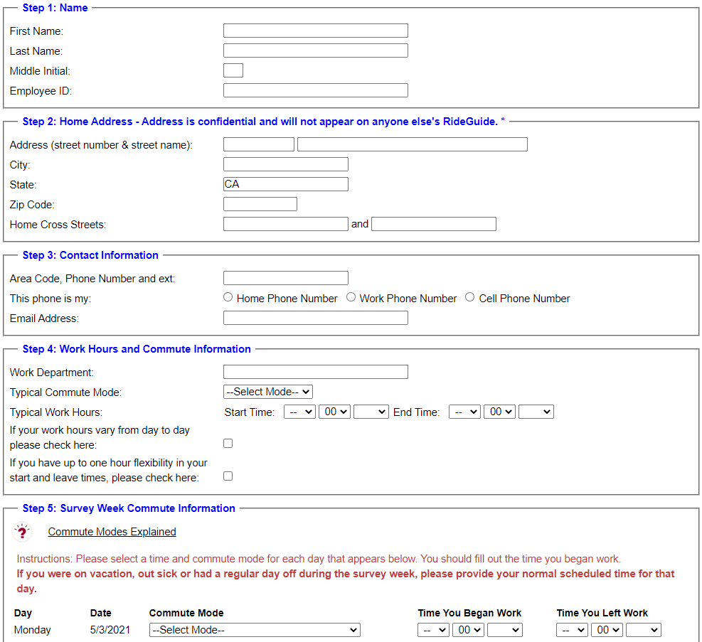
LA Metro Survey Tool
Notes:
Crucially the Metro tool also provides a super easy to use online survey that makes survey distribution a cinch.

Slide 29
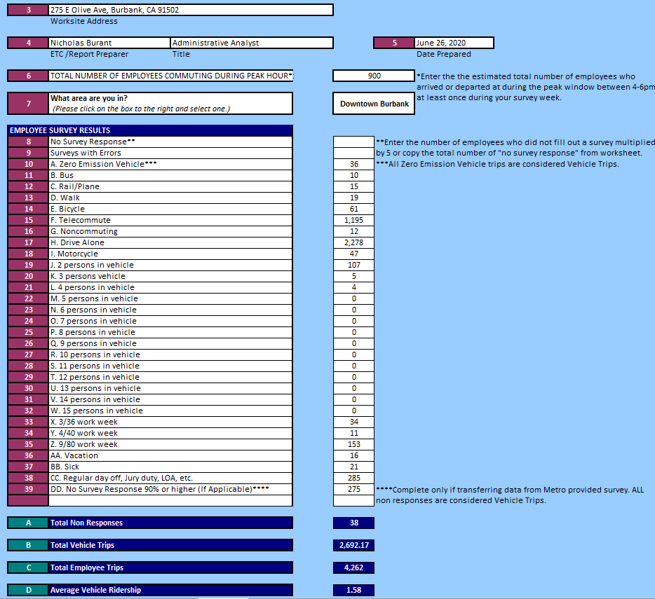
LA Metro Survey Tool
Notes:
When you’re finished, the AQMD tool will also provide you with results for the TMO survey. You can literally transpose the results directly into our survey tool.

Slide 30
LA Metro Survey Tool
Use the LA Metro Survey Tool!
It’s easy, free, and simplifies the process
Email Tiffany Fischer at fischert@metro.net to get set up
Notes:
I highly recommend using the LA Metro survey tool.
It’s easy, free, and it greatly simplifies the process.
To get set up, email Tiffany Fischer at fischert@metro.net

