Slide 1
BTMO All Commuters Meeting
April 16, 2024

Slide 2
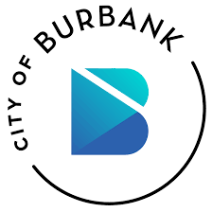
Agenda/Presenters
Karen Pan, City of Burbank
Laurene Lopez, Metrolink
Jocelyn Feliciano, Metro E-Pass
Stephanie Molen, LA Metro Programs/Updates
Tiffany Fischer, Ridematch
Matt Evans, NoHo to Pas BRT
Zoe Bertol-Foell/Destree Lazo Bascos, BTMO

Slide 3
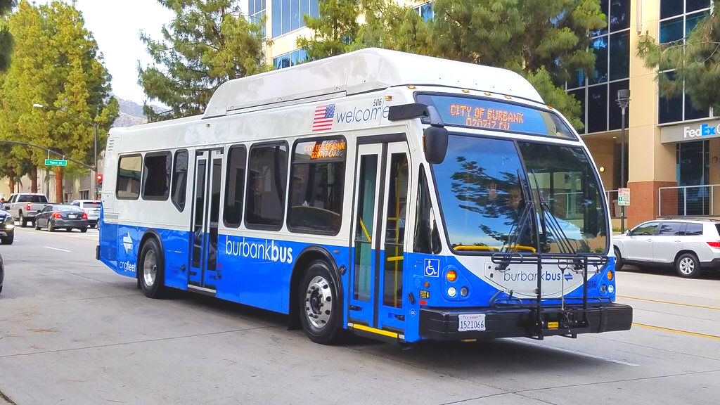
BurbankBus

Slide 4
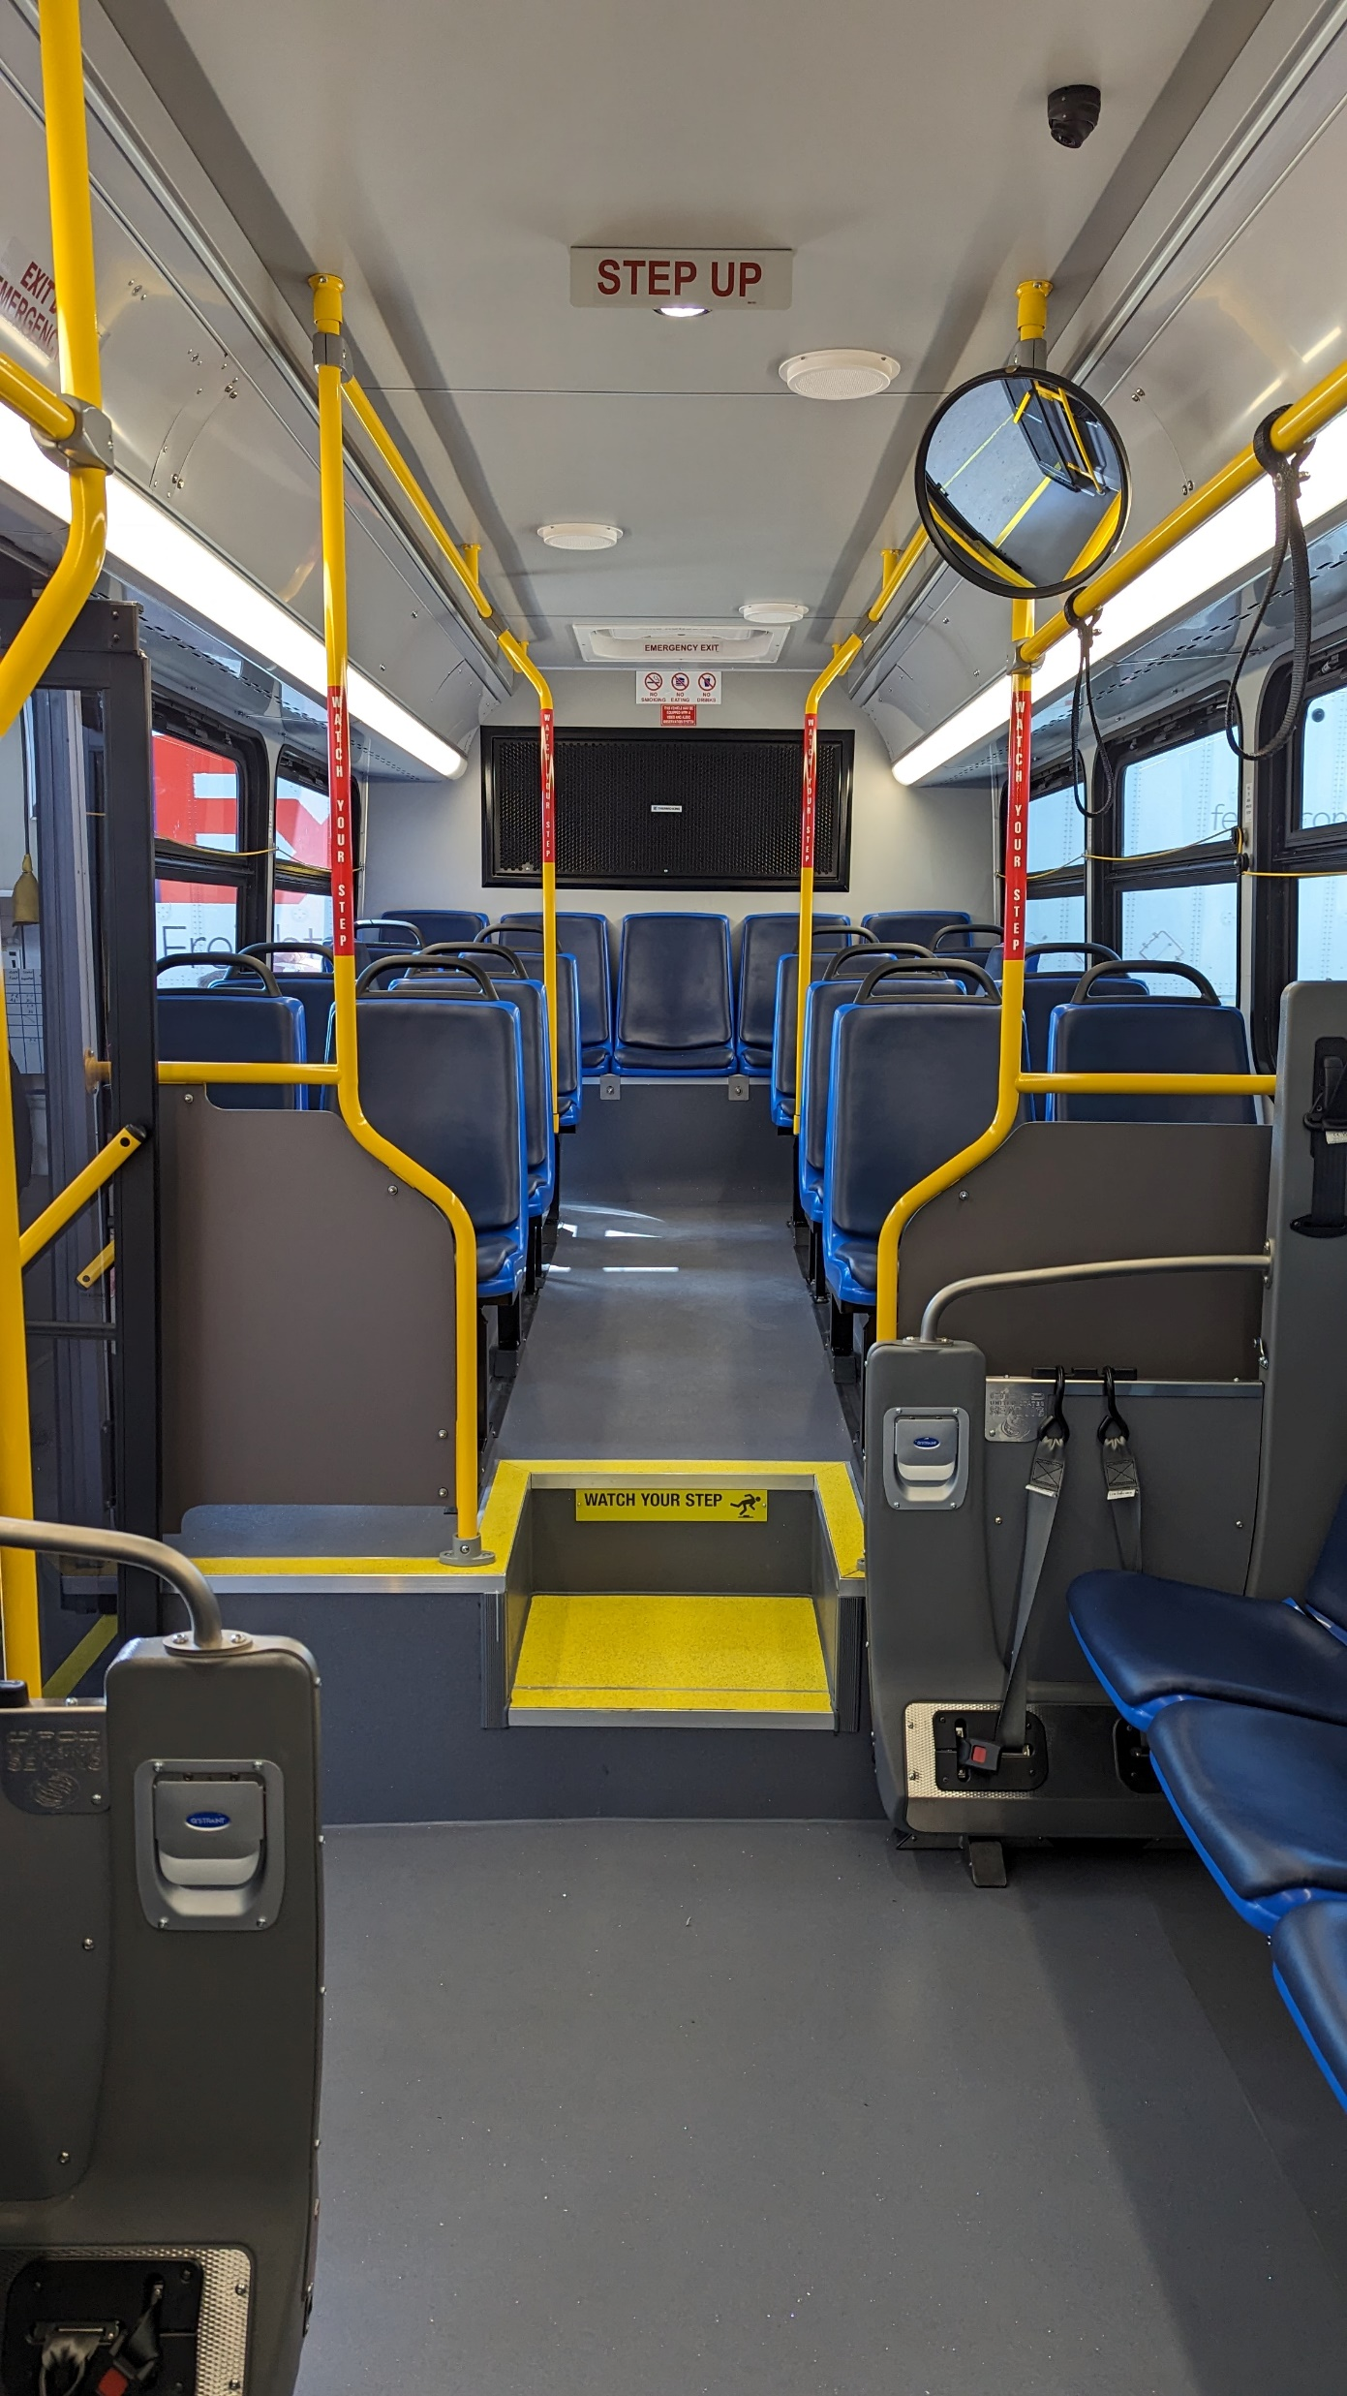
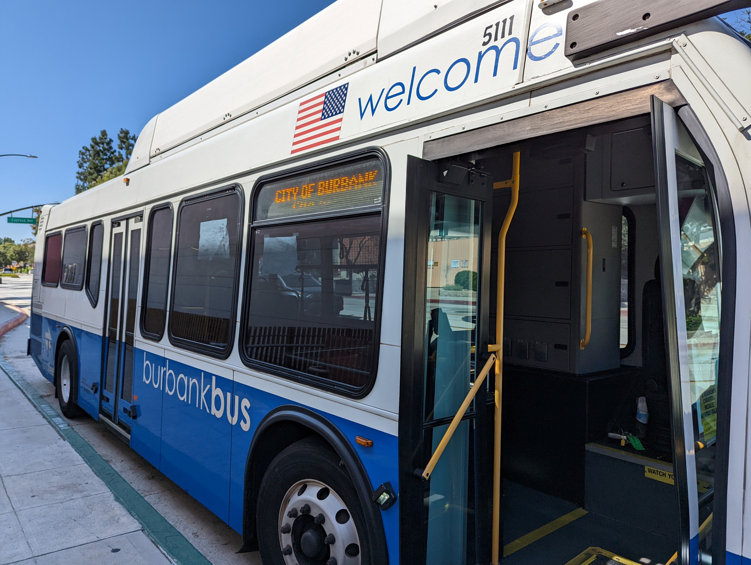
BurbankBus

Slide 5
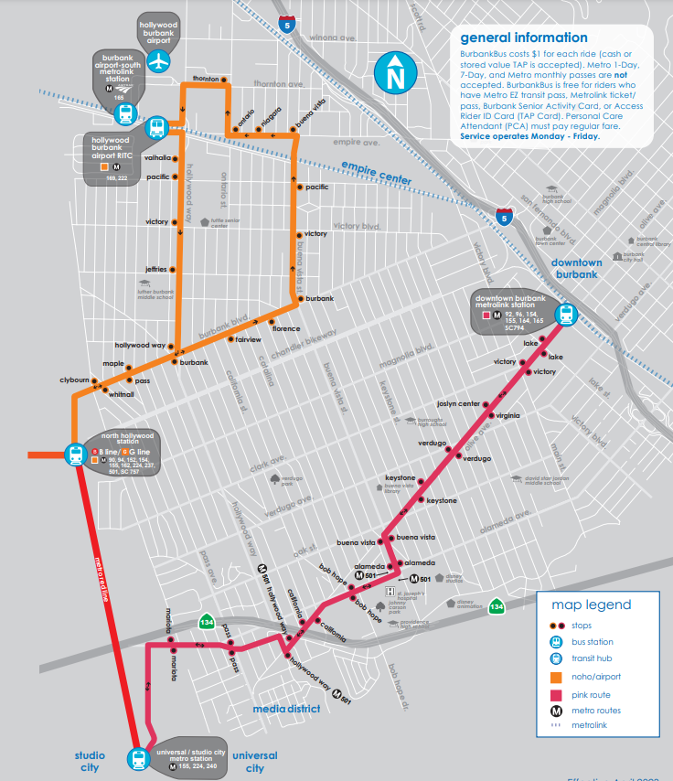
BurbankBus
$1.00 per ride
12 and under – Free with Parent
Free for Burbank students with valid student ID

Slide 6
BurbankBus
Monday through Friday
5:30 AM – 11:00 PM

Slide 7
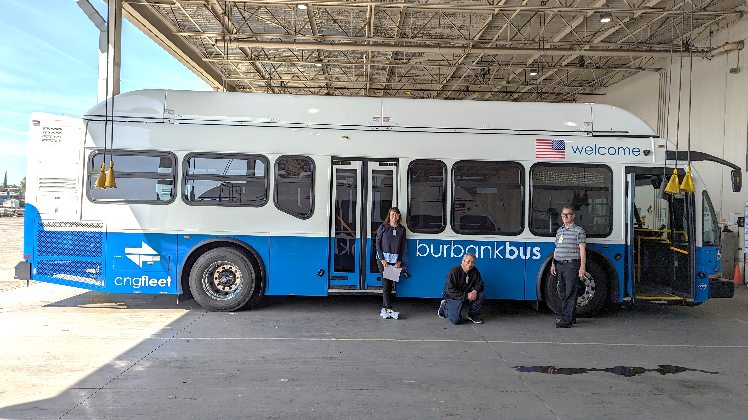
BurbankBus

Slide 8
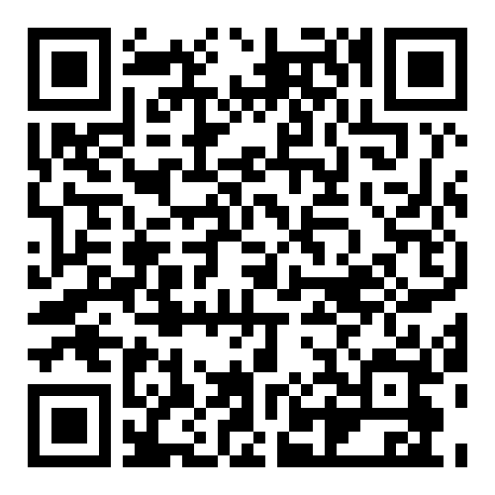
https://fp.mysocialpinpoint.com/burbank-bus-coa

Slide 9
Contact Information
Website: www.burbankbus.org
Karen Pan
Transportation Services Manager
(818) 238-5187
kpan@burbankca.gov

Slide 10
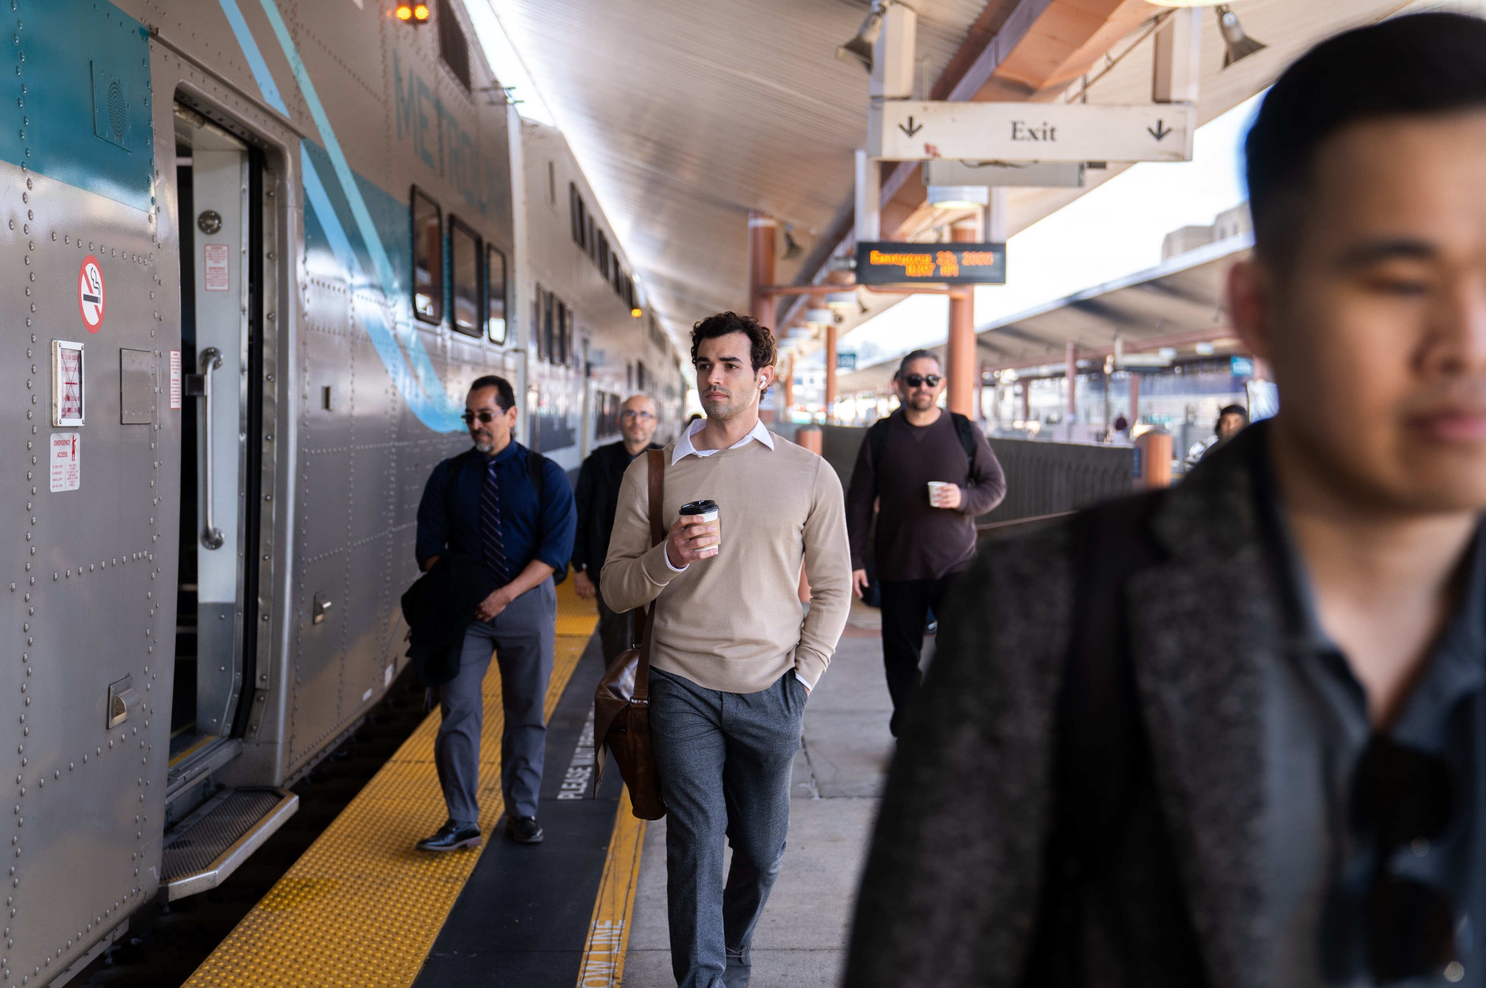
BTMO All Commuters Meeting
April 16, 2025

Slide 11
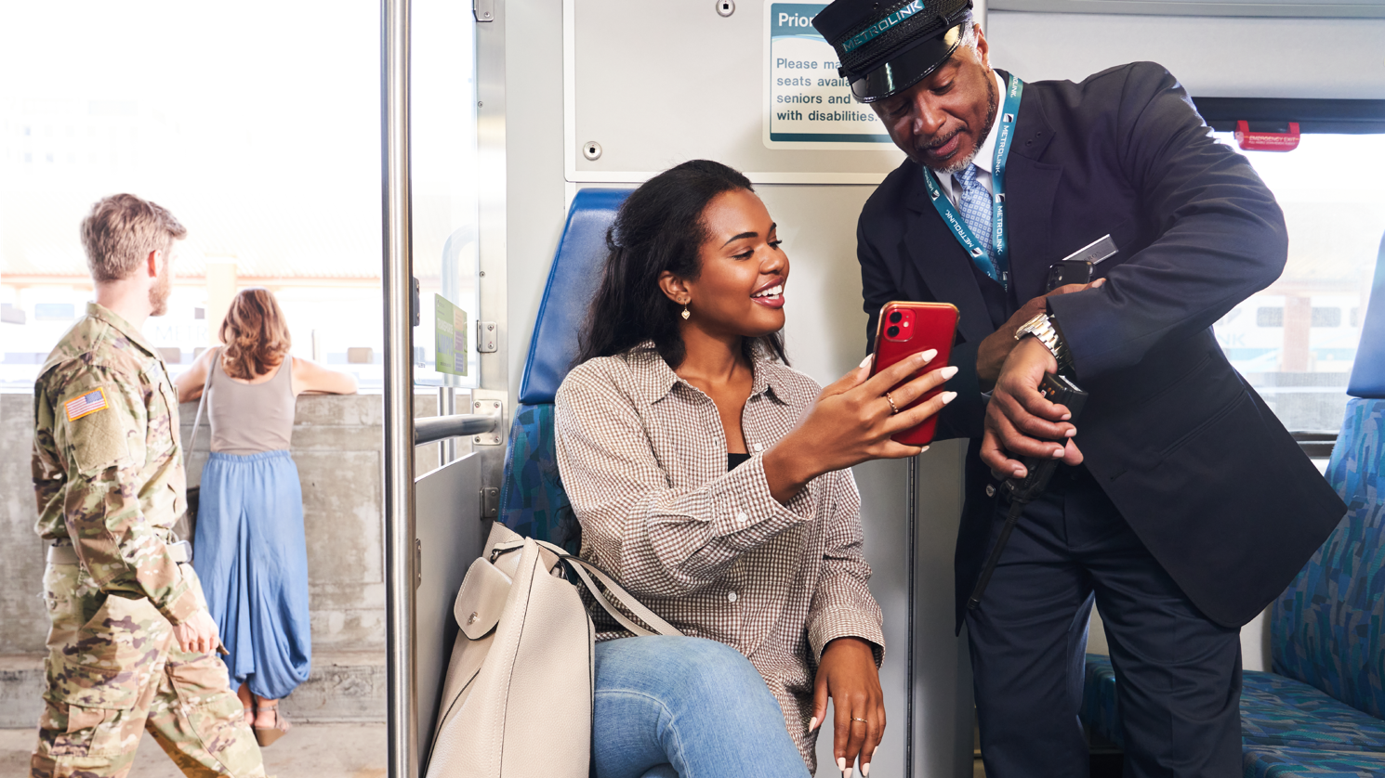
Agenda
Metrolink Overview
Corporate Partner Program
Mobility-4-All
Earth Day

Slide 12
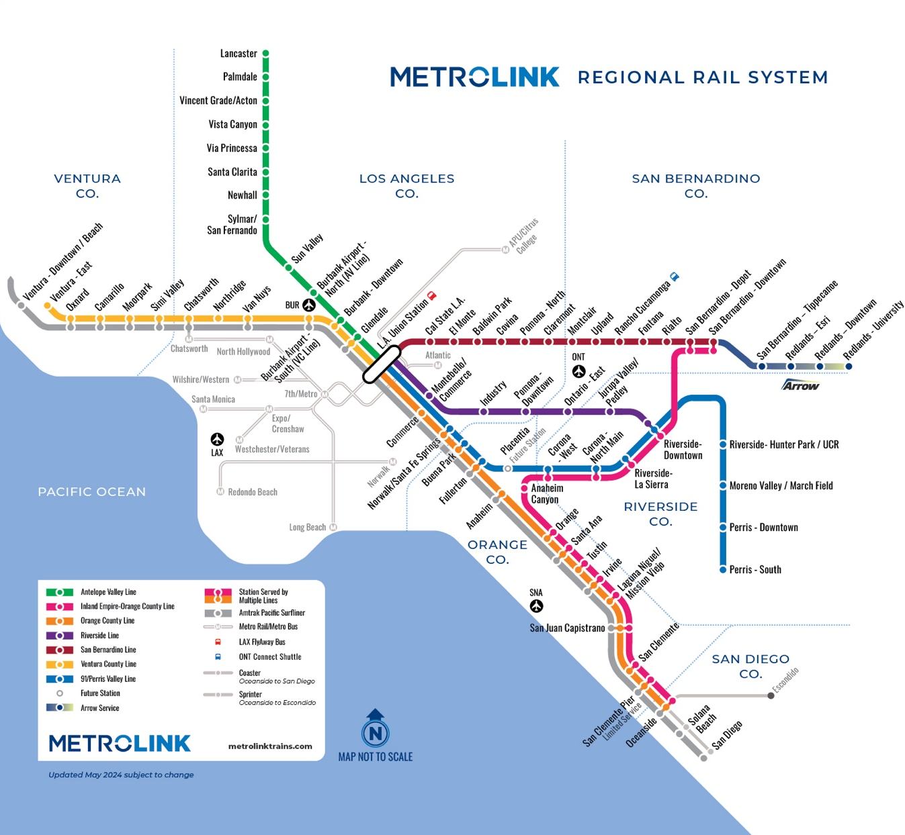
Metrolink is the only regional transportation solution, connecting the six counties in Southern California. Spanning over 545 service miles, Metrolink is the largest regional rail in California and 3rd largest in the United States.
Over 5 million riders trust Metrolink every year to connect them to the people and places they care about in Southern California.

Slide 13
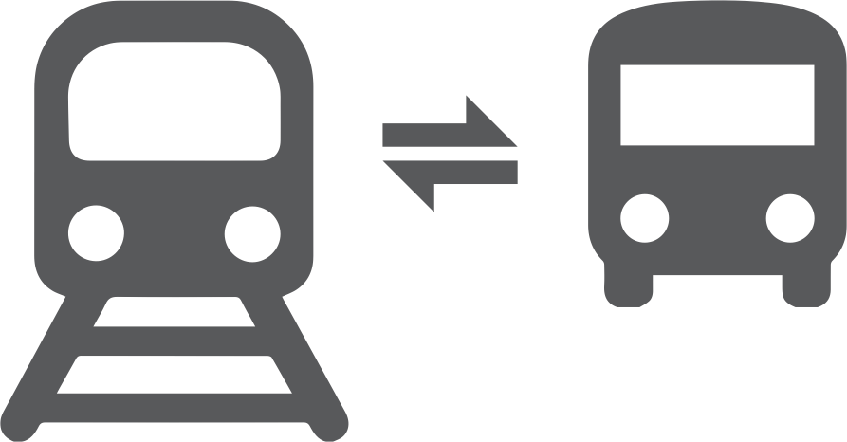
Rapid commutes
Employees save time, arrive to work on time, relaxed and ready to start the work-day
Go green and save
Employees save on gas and car expenses, while reducing their carbon footprint and supporting Corporate Sustainability initiatives
Free connecting transit
All Metrolink passes include free transfers to most connecting bus and rail
Clean, comfortable multi-level cars
Safety is a priority, allowing employees to relax, visit with friends or catch up on work
Free weekend travel
Monthly Pass holders can enjoy free system-wide travel on the weekends and Kids Ride Free on weekends, too

Slide 14
Corporate Partner Program
Metrolink’s Corporate Partner Program is a pre-tax benefit program that enables companies and organizations the ability to offer transit benefits to their employees using a maximum of $325/month per employee.
The Corporate Partner Program satisfies AQMD Rule 2202 requirements.
Notes:
For more information go to metrolinktrains.com/cpp or email cppservice@scrra.net

Slide 15
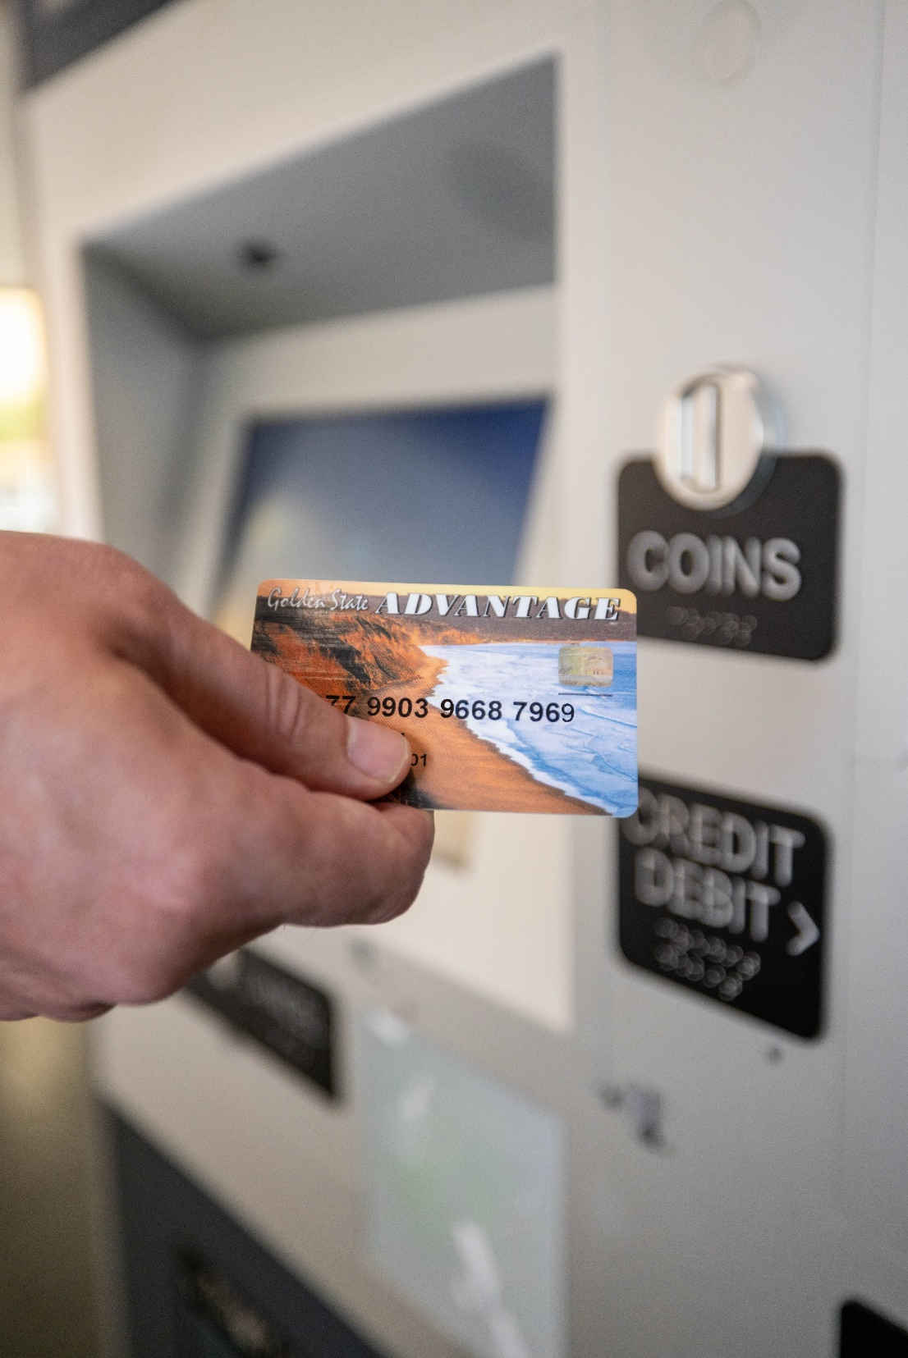
Mobility-4-All
California EBT cardholders are eligible for an additional 50% fare discount.
Simply insert California EBT card into Metrolink ticket vending machines to unlock the 50% discount.
Available only at Metrolink Ticket Machines.
Applies to all Metrolink ticket types.
In addition to existing discounts.
Notes:
The Metrolink Low-Income Fare Discount Program is made possible by a $5.7 million dollar grant from the Low Carbon Transit Operations Program (LCTOP), administered by the California Department of Transportation (Caltrans).
Metrolink is committed to providing safe, affordable transportation for everyone and we are proud to further promote equity in public transit with this new discount program.
The Low-Income Fare Discount Program provides a 50% fare discount for California Dept. of Social Services EBT cardholders throughout the entire Metrolink service area for approximately one year, from September 1, 2022 - August 31, 2023, or until the funds are exhausted.
When a customer inserts a California Dept. of Social Services EBT card into Metrolink ticket vending machines, it unlocks the 50% discount. An alternative form of payment is needed in order to complete the transaction.
The discount is only available via Metrolink ticket machines.
The Metrolink Low-Income Fare Discount Program applies to all Metrolink commuter rail trip types, times, origin/destinations and is in addition to current discounts already in effect.

Slide 16
Earth Day
On Tuesday, April 22, we’re inviting everyone to leave their car at home and ride Metrolink for free.
It’s not just a free ride, it’s a journey towards a greener, more vibrant Southern California!
Notes:
Ride free on Metrolink all day.
Many local buses and trains—including Metro (Los Angeles), Omnitrans (San Bernardino), and transit agencies in Orange, Riverside, and Ventura counties—are also offering free rides on Earth Day.
No ticket necessary

Slide 17
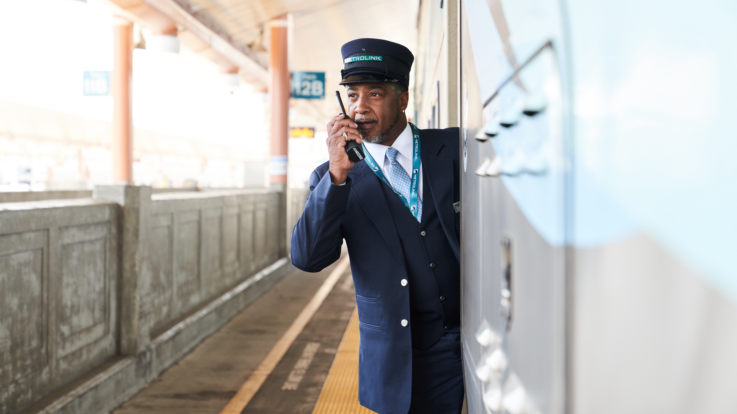
Thank you!

Slide 18
Metro Employer Pass Programs

Slide 19
Pass Programs
Employer Pass Programs
Annual Transit Access Pass
(A-TAP)
Small Employer Pass
(SEP)
Employer Pass Program
(E-Pass)
Pay Per Boarding
Program
Annual Programs
Annual Pass
Full Fare ($1320 + $5)
26 EZ Pass Agencies
Minimum: 3 Passes
Annual Upfront Payment
Photo ID TAP Card
Annual Pass
Reduced Fare ($408 + $5)
Metro Bus & Rail Only
Minimum: 50% of total employees
Upfront Annual Payment
Photo ID TAP Card
Reduced Fare ($80/mo. max.)
Valid on 15 transit agencies
Quarterly payment for usage
RFID Sticker on Employer ID

Slide 20
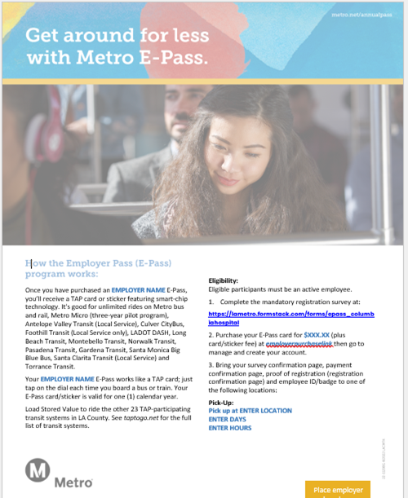
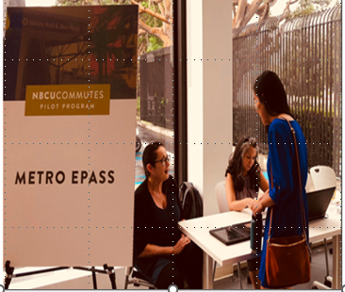
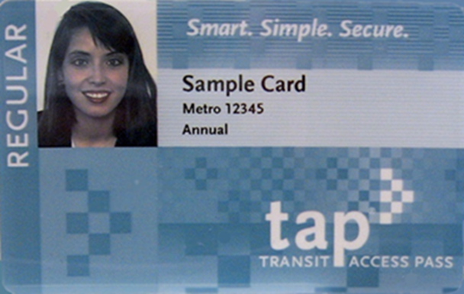
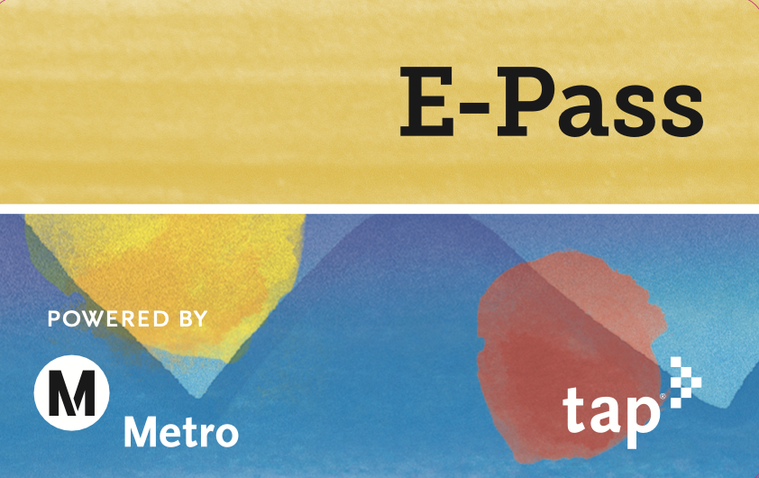
Pass Programs –Marketing Materials and Clients

Slide 21
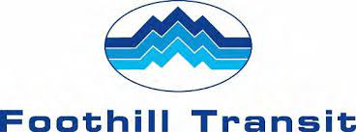
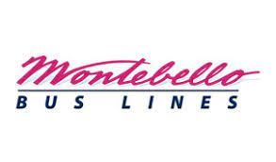
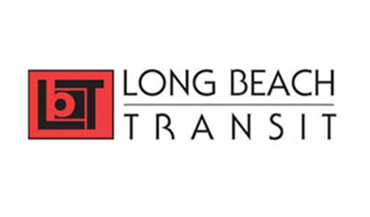
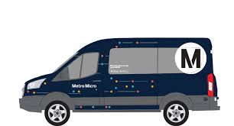
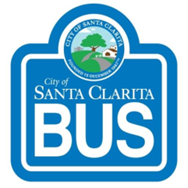
E-Pass Program- Participating Agencies: Fare per Boarding (Cont.)
AVTA (Local)
Culver CityBus
Foothill (Local)
Gardena (Gtrans)
LADOT DASH
Montebello
Long Beach
Metro
Micro Transit
Montebello
Norwalk Transit
Pasadena Transit
Santa Clarita
Santa Monica Big Blue Bus
Torrance Transit
E-Pass on 15 Transit Agencies

Slide 22
Thank You
Jocelyn Feliciano
Director, Commute Services
felicianoj@metro.net
213-922-3895

Slide 23
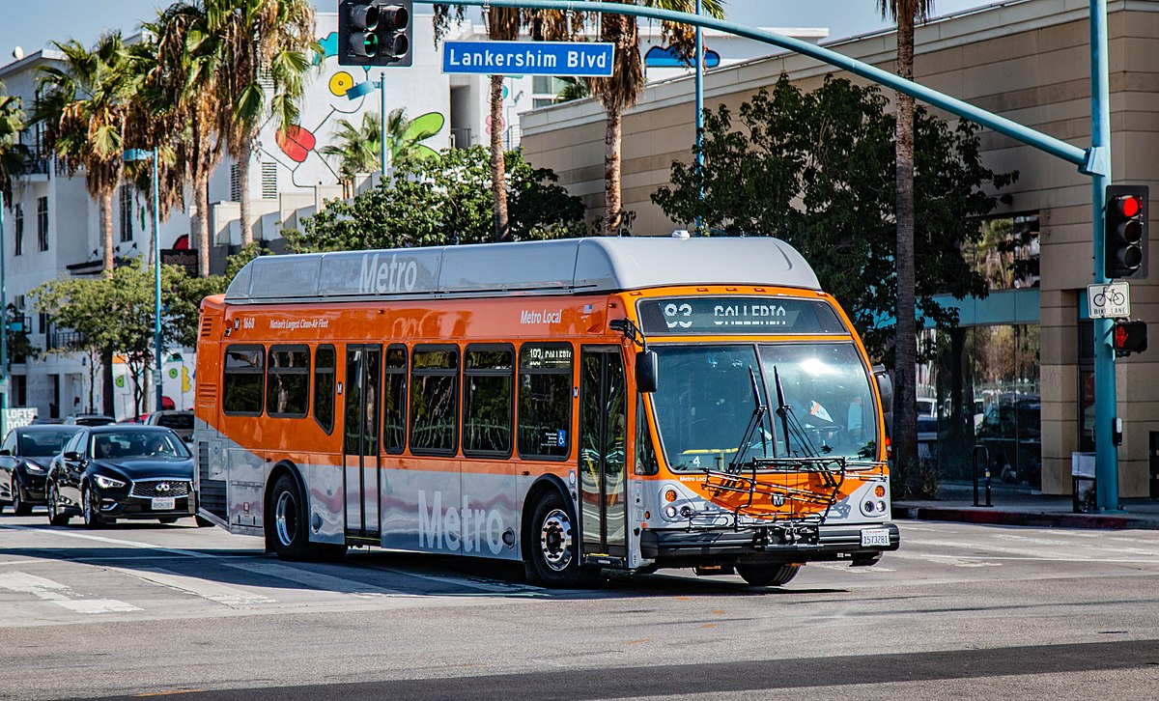
Services and Programs
LA Metro

Slide 24
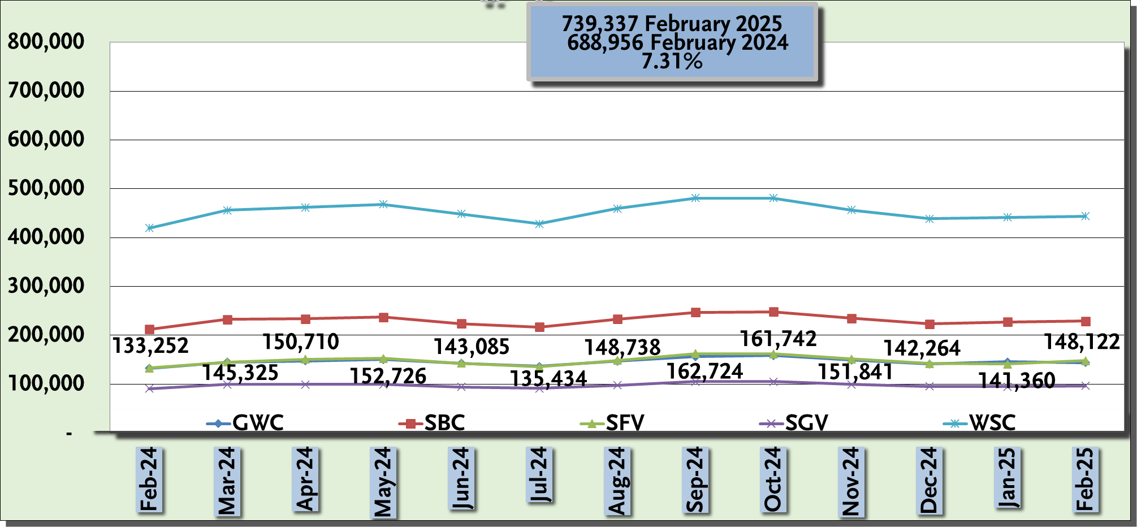
Average Weekday Metro Bus Ridership Update Feb 2024 to Feb 2025
24

Slide 25
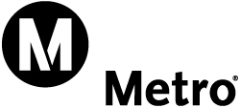
Ridership at Key Burbank Destinations
Downtown Burbank Station
Feb 2025 - 382 Daily Boardings
Feb 2023 - 364 Daily Boardings
Feb 2022 - 395 Daily Boardings
Olive / Hollywood Way
Feb 2025 - 53 Daily Boardings
Feb 2023 - 44 Daily Boardings
Feb 2022 - 34 Daily Boardings
Olive / San Fernando
Feb 2025 - 373 Daily Boardings
Feb 2023 - 356 Daily Boardings
Feb 2022 - 305 Daily Boardings
Alameda / Buena Vista
Feb 2025 - 100 Daily Boardings
Feb 2023 - 71 Daily Boardings
Feb 2022 - 61 Daily Boardings
25

Slide 26
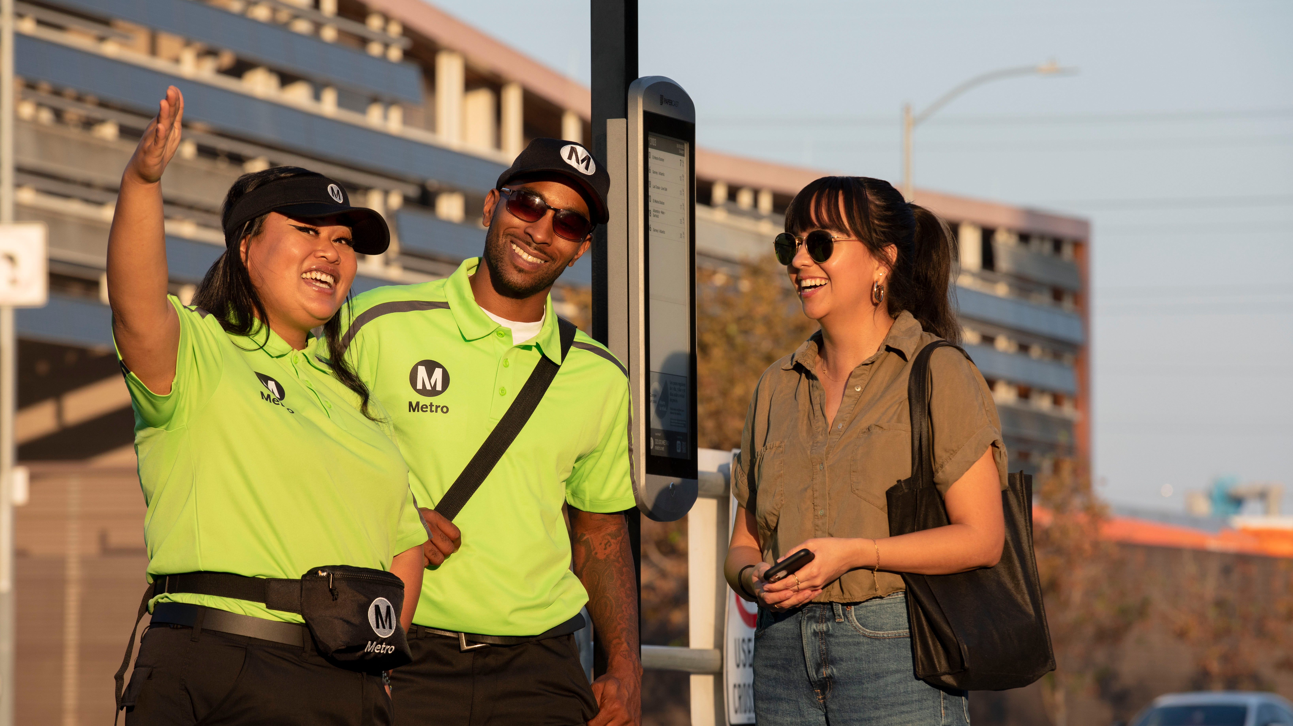
Support, Connect, and Report
Our ambassadors will support riders and safety, connect riders to resources and report incidents
Notes:
Metro Ambassadors are here to support riders on Metro buses, trains and stations, connect them to resources and report maintenance and safety concerns.

Slide 27
Metro’s Public Safety Eco-System
> Respond to mental health crisis incidents
Crisis Response Teams
Metro Transit Security
Contracted Security
Homeless Outreach
LA Metro Riders & Employees
Transit Ambassadors
Law Enforcement
> Visibility > Response to crime
> Customer information
> Security awareness
> Visibility
> Outreach to riders
> Connection to services
> Security Ops Center
> Patrol facilities
> Code of conduct
> Open/close stations
> Patrol and secure facilities
> Support emergencies & special events
27

Slide 28
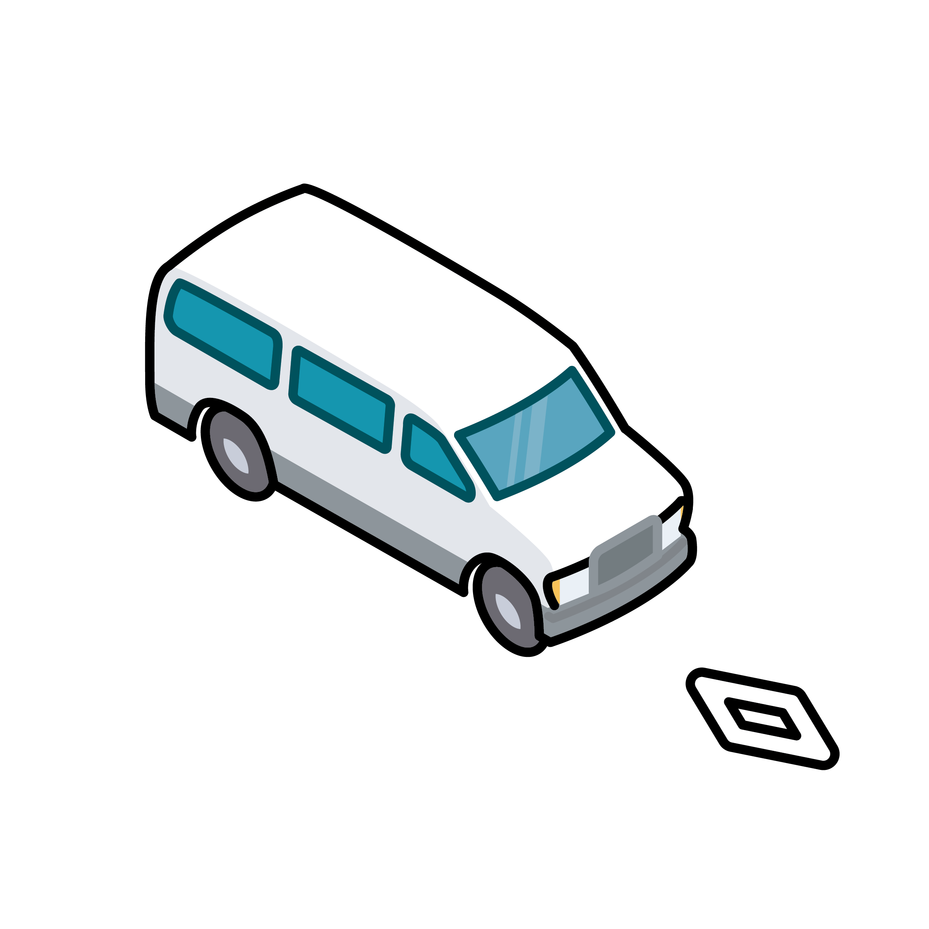
Metro Vanpool Program
Program launched in May 2007
Current number of vans: 800+
Vanpools currently receive up to a $600 monthly subsidy
New Vanpool Bonus: $200 for first month
High-Occupancy Bonus: $100 ongoing while 70% occupancy is maintained
Leasing Vendor options: Enterprise, AVR, Green Commuter
For more information, contact us at vanpool@metro.net or call 213-922-7003

Slide 29
Metro Bike Share
225 stations in DTLA and Central LA (including Hollywood), North Hollywood and on the Westside.
1,800 Metro Bikes available including both Classic and Electric.
Since launch in 2016 – 2.6 million trips
Cost:
$1.75 per 30-minute ride
$5.00 for a 24-Access pass
$17.00 for a 30-Day pass
$150.00 for a 365-Day pass
Reduced Fare passes available
Visit metro.net/bikeshare for more information

Slide 30
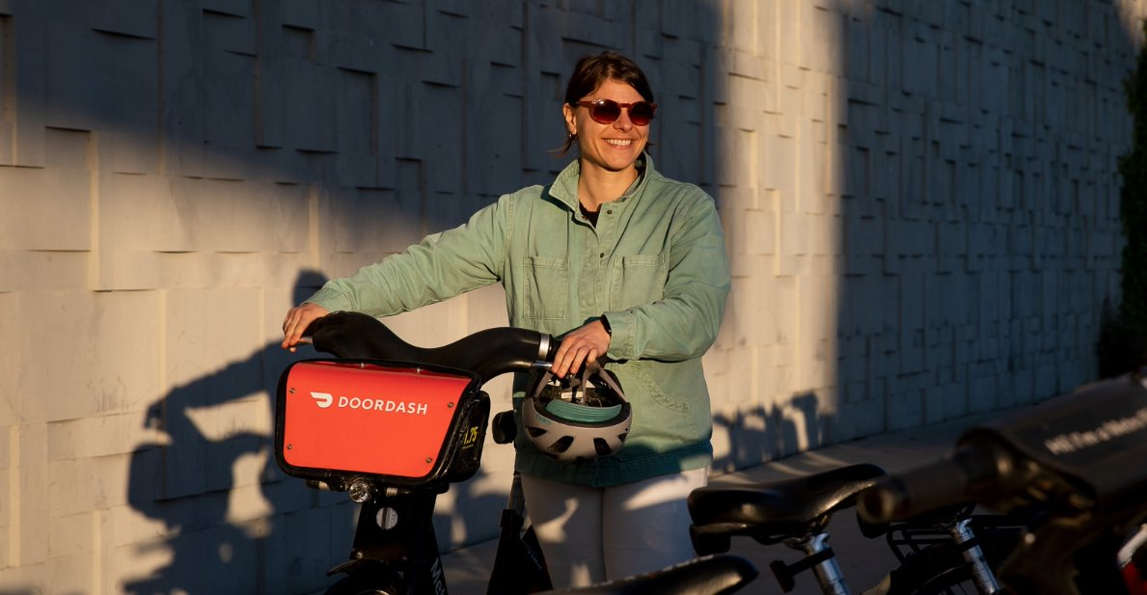
Bike Share for Business
Pedal Perks & Refer a friend
Employers pay $89 for each employee and separately determine how much employees contribute.
Minimum commitment of five employee passes each year.
Pedal Perks
30-Day or 365-Day passholders can earn and accumulate points with each Metro Bike ride. Earn extra points for different tasks such as riding from full stations or returning bikes to empty ones. Use points to get limited-edition Metro Bike Share gear!
Refer a Friend
30-Day and 365-Day Passholders can get two free weeks of bike share each time they refer friends and family to join Metro Bike Share.
Your friends will get a 30-Day Pass for just $1!

Slide 31
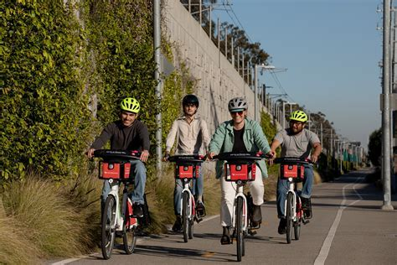
UPCOMING EVENTs
Earth Day on April 22nd
Free 30-minute rides with promo code 042225
Bike Month in May
30-Day Bike Share passes available for just $1.00 during May with promo code BIKEMONTH25.
365-Day Bike Share pass 50% off during Bike Week with promo code BIKEWEEK25.
Bike Day on May 15th – Free 30-minute rides with promo code 051525
Redeem free 30-minute bike share rides by selecting ‘1-Ride’ at any kiosk, online or in the app by entering the promo code. A credit or debit card is required.
First 30 minutes are free. Rides longer than 30 minutes are $1.75 each additional half-hour. Electric Metro Bike unlocking fees are waived.

Slide 32
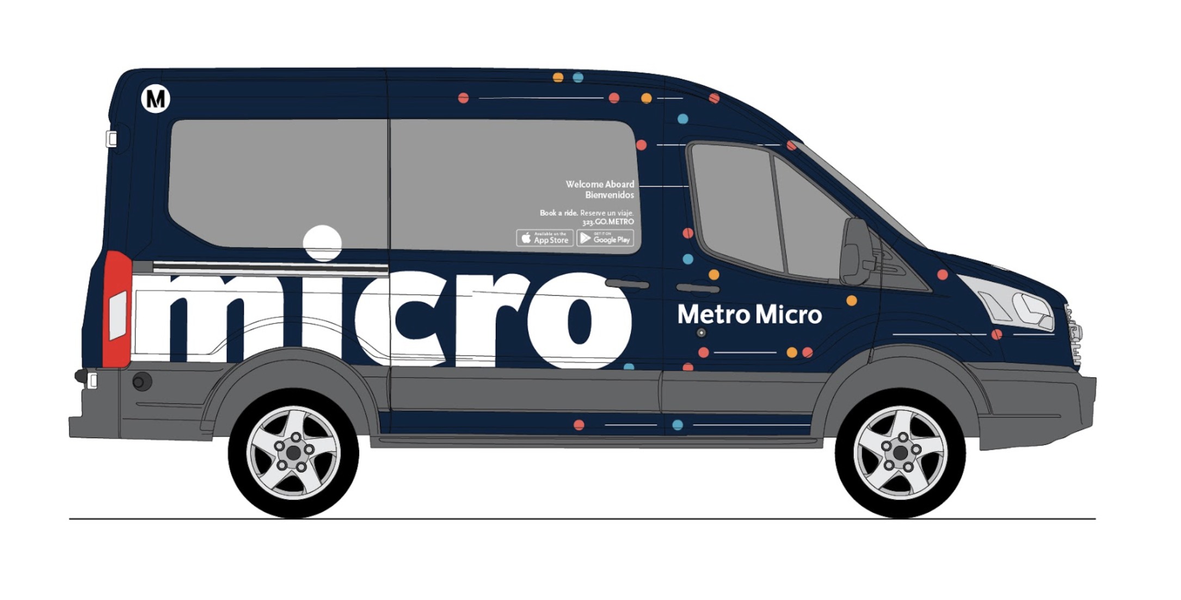
What is Metro Micro?
Metro Micro is a microtransit program, recently extended another 3 year to April, 2028
> Micro is Metro’s on-demand rideshare service offering short trips (1-5 miles).
> Service with vehicles for up to 8 customers. Serves as a first/last mile option for bus and rail system users as well as stop-to-stop travel across the entire zone.
> Pay using a TAP card or credit card. TAP cards with stored value can be used directly on Metro Micro vans using a validator.
Cost to Ride
$2.50 per trip
Transfer to fixed route and other TAP discount program included
Notes:
* The pilot was launched December of 2020 and will operate through December of 2023 * The introductory period allows Metro time to evaluate demand, affordability and other factors in ensuring that the full fare price is equitable for the communities that Metro Micro serves.

Slide 33
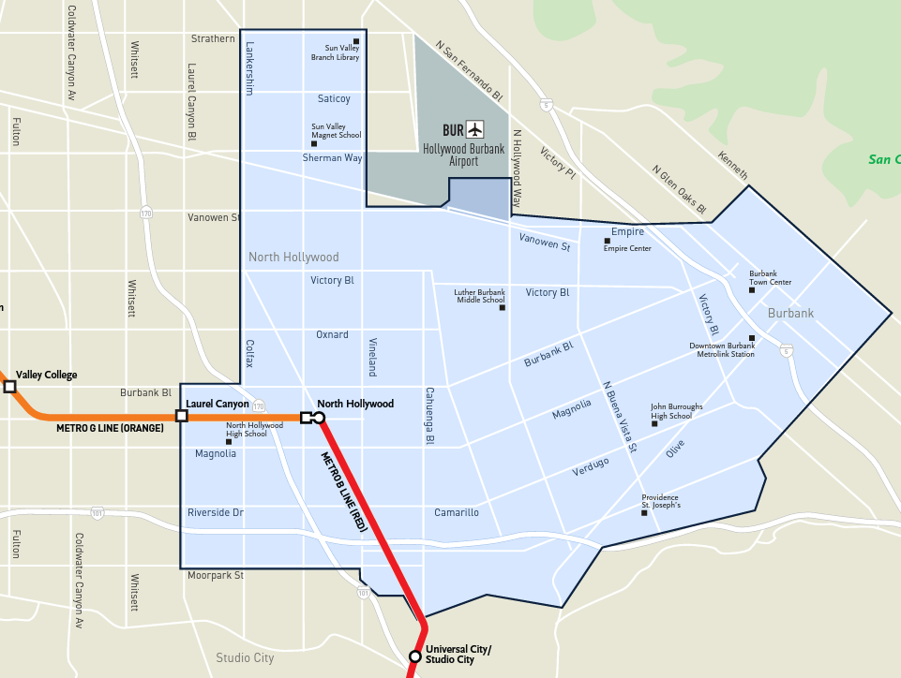
North Hollywood / Burbank
Burbank Highlights
> Hollywood Burbank Airport
> Burbank Town Center
Providence Saint Joseph Medical Center
Universal City/Studio City Station
Metrolink Stations
> Burbank Airport South (Ventura County Line)
> Downtown Burbank (Antelope Valley Line)
Metro G Line (Orange) & Metro B Line (Red)
> BRT: Laurel Canyon Station
> BRT/Rail: North Hollywood Station
Expanded Hours of Operations *
> 6 am to 10 pm, Monday - Friday
> 10 am to 10 pm, Saturday & Sunday
* In an analysis of usage before and after these hours were extended, average weekday ridership rose 47%.
Notes:
Initial Hours of Operations were 10am – 10pm
The Burbank Airport terminals are now included *because of* the Burbank Transportation Management Organizations and a previous presentation made
We want to thank the TMO’s enthusiasm for Micro and the Hollywood Burbank Airport Authority’s gracious assistance in helping Metro Micro serve Burbank Airport terminals
We can report that in an analysis of usage before and after these hours were added, our average weekday ridership rose 47%. Of new users gained between the analysis periods, 57% rode in the added hours.

Slide 34
Contact us
micro@metro.net
metro.net/micro
Losangelesmetro
@metrolosangeles

Slide 35
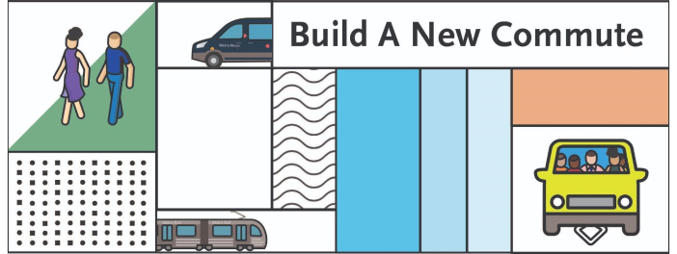
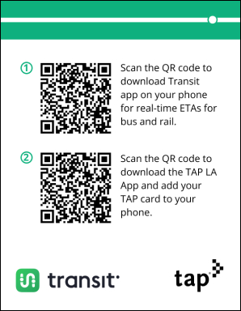
Travel Rewards Research Pilot
Researching what works to nudge people who are driving alone to try transit, carpool, vanpool, walk, bike or telework. $700K Federal Transportation Authority (FTA) grant collaboration between Metro’s Office of Strategic Innovation and Countywide Planning and Development.
Pilots developed by Behavioral Scientists from Duke University
List of Pilots:
Telework – Completed
Nudges to help support productivity and optimize happiness
Build A Better Commute (LAX/LAWA) – Completed
Encourage employees to carpool to LAX with other employees
One Car Challenge (Santa Monica) – Completed
Encourage 2 car households to give up 1 car for a month
Go Verdugo Commuter Challenge – Fall 2025
Encourage commuting via transit, carpool, walk, bike, vanpool
Notes:
This program offers commuters incentives to take transit, carpool, vanpool, walk or bike instead of driving alone. ​
Each pilot is structured by Behavioral Scientists from Duke University to help study what best creates behavior change Randomize interventions—similar to clinical trials. ​ Measure what has the best ROI with robust data collection and analysis
Share findings with the county in order to implement successful TDM incentives based on data.

Slide 36
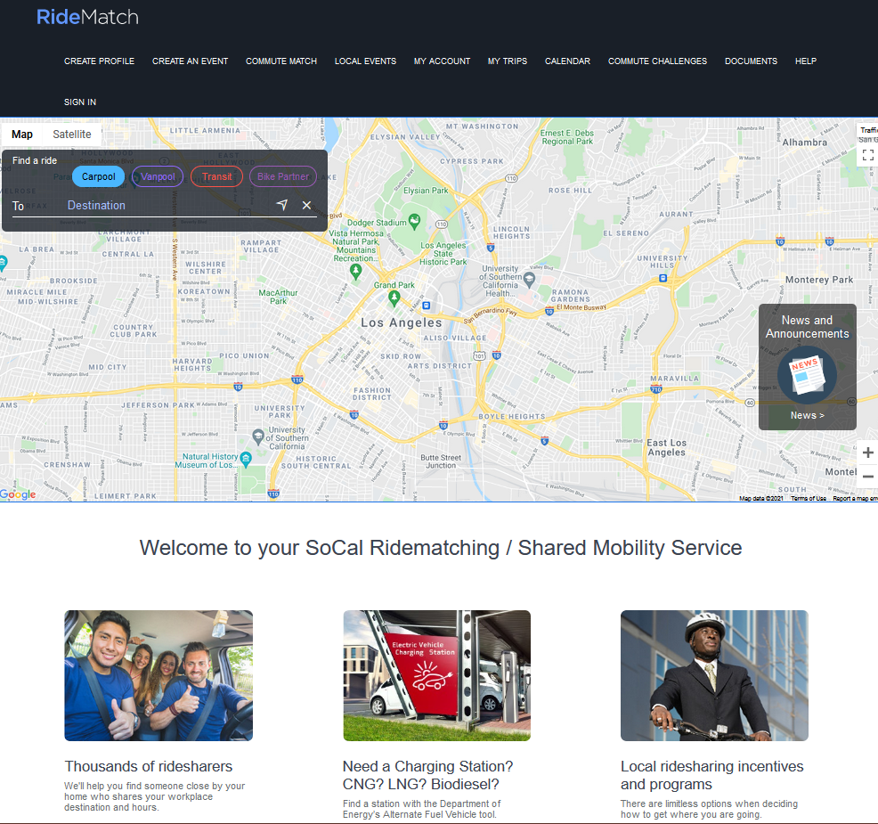
Ridematch.info
Find carpool, vanpool, and bike partners
Find transit routes and Park & Ride lots
Printing “RideGuide” is an option
Find locations for Alternate Fuel and EV Charging Stations

Slide 37
Ridematch.info
Create Profile
Commute Match
Calendar
Commute Challenges

Slide 38
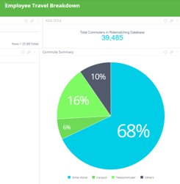
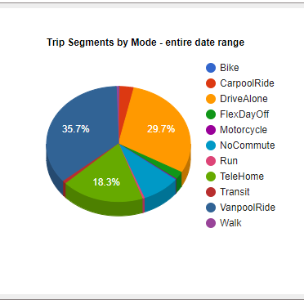
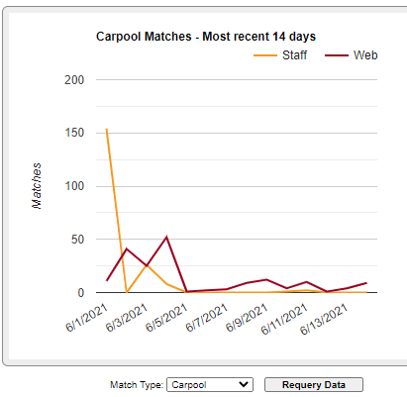
Metro Regional Rideshare Employer Support
ETC support is available at no cost for assistance with implementing local trip reduction ordinances or SCAQMD's Rule 2202 ECRP (Rideshare Program) at your worksite. Get help with AVR surveying, calculations, and access to your employee survey data online. Monthly briefings are offered to ETCs free of charge.

Slide 39
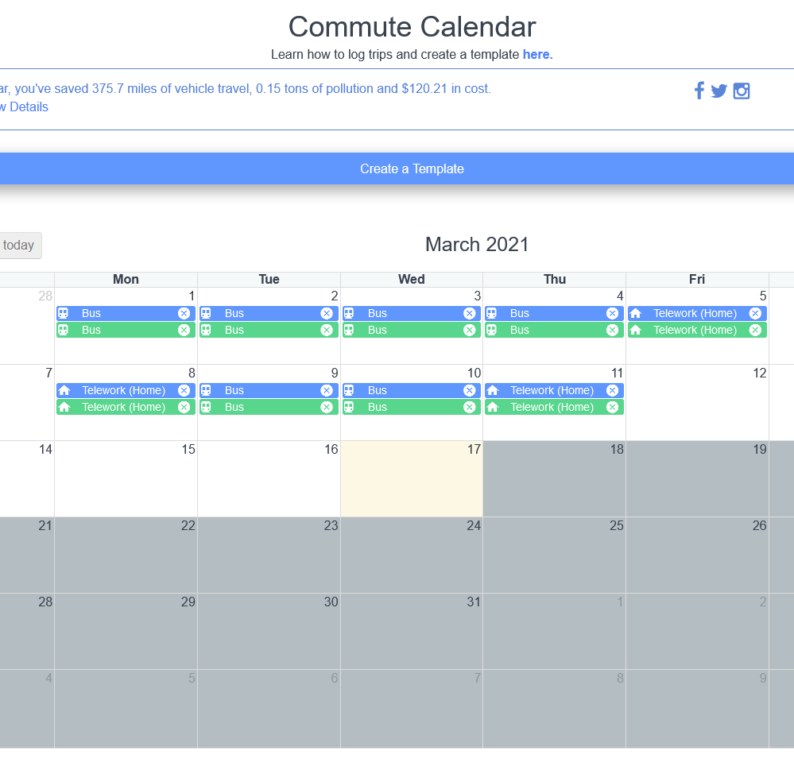
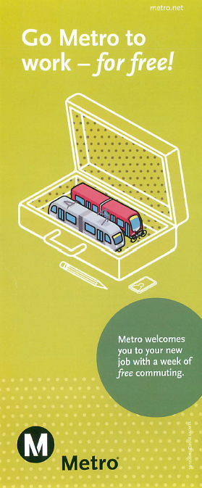
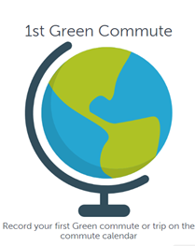
Metro Incentive Program
Go Metro to Work Free
Provides a free 7-Day Metro TAP card, a $25 value, to newly hired employees at participating worksites
Metro Rewards Provides monthly prize drawings for employees who register and track their commute trips online at ridematch.info via computer or mobile device.

Slide 40
Regional Guaranteed Ride Home Program
The Regional Guaranteed Ride Home (GRH) Program provides a safety net, which allows employees to rideshare to work without the worry of getting stranded at work due to illness, unexpected overtime or other emergency.

Slide 41
Metro Commuter Options
For more information contact your Representative Tiffany Fischer at
FischerT@metro.net
Commuteroptions@metro.net
(213) 922.4233

Slide 42
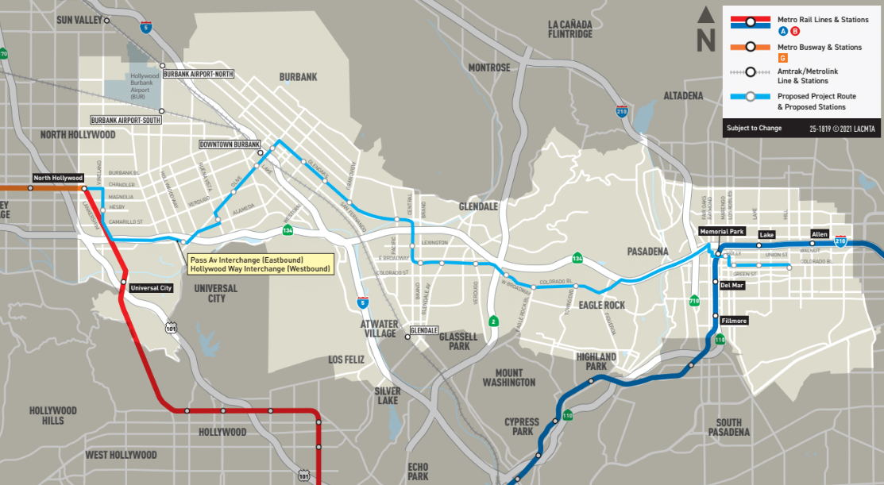
Proposed Project
Approximately 19-mile corridor with 22 enhanced stations
6 stations in Burbank with connections to Media District, Downtown Burbank, and Metrolink
Improves service reliability and customer experience; total peak travel time savings of 34-44%
Enhanced connectivity to Metro Lines A, B, and G
Anticipated to attract 30,000 daily riders when it opens
42
Notes:
Approximately 19-mile corridor with 22 enhanced stations
Improves services reliability and customer experience; Total travel time savings of 34-44% during peak periods
Improves service reliability and customer experience

Slide 43
Project Status
Current Project Schedule
Design: The project is now in the design stage before it enters construction in late 2025/early 2026
Utility exploration activities to begin mid-2025
Metro is utilizing a Construction Manager/General Contractor (CM/GC) project delivery method and awarded to Myers/Shimmick in December 2024.
Quarterly Community Meetings planned through construction.
4

Slide 44
Trip Reduction Survey
32 employers made up of 20,081 employees (and 16,177 peak hour commuters) submitted survey reports
AVR scores in 2024 continued to decline from 2023 but still remain above 2019 pre-pandemic levels, despite the increase employees returning to work in person
The weighted average Citywide AVR was 1.37, below the 1.6 target.
Location | 2024 Average Vehicle Ridership (Weighted Average)
Media District/ Airport Area | 1.35
Downtown | 1.57
Citywide | 1.37

Slide 45
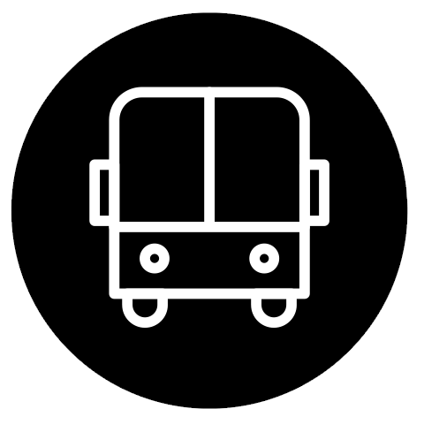
Trip Reduction Survey
Telecommuting rate continued to decline from 28% in 2023 to 20% in 2024
The SOV rate increased to 75%, compared with 67% in 2023 and 85% before the pandemic
Some sustainable mode shares, including Carpool/Vanpool and biking shares declined slightly (by .3% and .1% respectively)
Transit share increased from .8% to .9%
Notes:
Clean Air Day microgrant funding

Slide 46
BTMO Vanpool Subsidies
Group Subsidy:
Start a new Vanpool
Individual Subsidy:
Join an existing Vanpool
$200 per month for the first 6 months
Can be paired with Metro’s vanpool subsidies of up to $700 per month
$40 per month for 6 consecutive months
Notes:
Clean Air Day microgrant funding

Slide 47
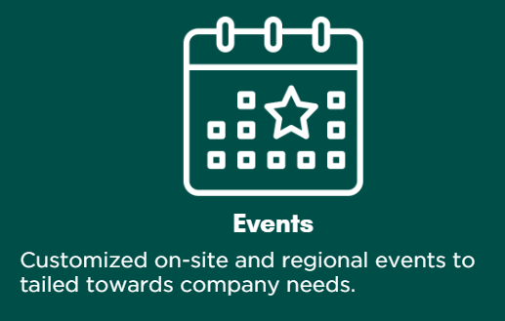
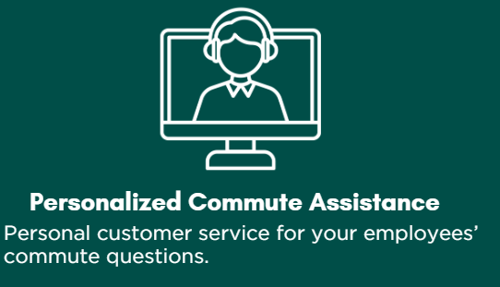
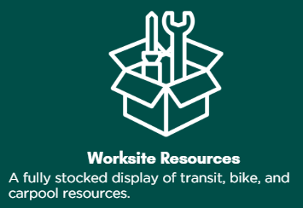
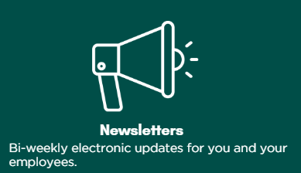
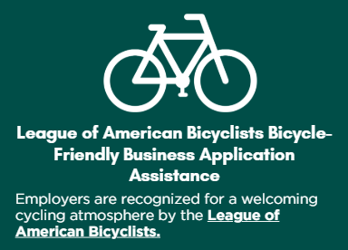
Member Services

Slide 48
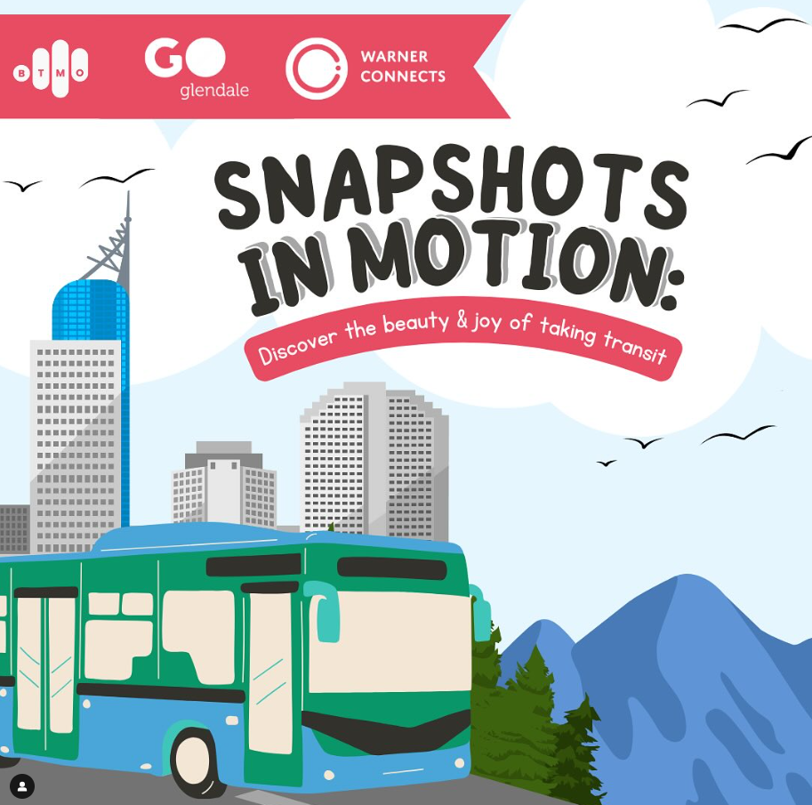
Upcoming BTMO Events/Campaigns
Join our Snapshots in Motion Campaign for a chance to win!
Upload a picture to our transit-friendly destination guide by April 30 to be entered in the chance to win $30-$50 gift cards, a Kindle, a cooler backpack, or a bike kit gift basket!
Celebrate Earth Day with us at the 2025 Burbank Petal Party
On April 26th, celebrate sustainability in Burbank at Ralph Foy Park with sustainability activities, a bicycle obstacle course, roller skating, live music, and more!
May is Bike Month - Keep a lookout for BTMO promotions ​
Get ready for Bike to Work Day – April 14th ​
Bike to Work Day – April 16th
Notes:
Clean Air Day microgrant funding

Slide 49
Keep in Touch!
Follow us on Instagram and subscribe to our newsletter!
Stay up to date on local transportation news and helpful tips
Get the latest event updates and campaign announcements
Be the first to hear about new programs and perks!
Check out our website!
How-to guides for every travel mode
Monthly blog posts
Interactive mobility apps and bike route guides
Printable resources for your employees
And more!

Slide 50
We will be sending out contact information in case you have more questions!
Thank you!
Keep a lookout for an email with your free-Metrolink code!
Burbank Transportation Management Organization
director@btmo.org
213-425-0986
@thebtmo

