Slide 1


Annual Trip Reduction Survey
September 11th 2025

Slide 2
TDM Program Requirements
City Ordinance requires participation by all employers with 25+ employees
Employers must reduce peak period automobile travel by 38% (AVR of 1.6)
Burbank Transportation Management Organization
  Non-profit, assists employers to meet trip reduction goals
Annual Commute Survey
Notes:
The Burbank TDM ordinances require participation by all employers with 25 or more employees in the Media District and in Downtown Burbank.
Employers are required to reduce their peak period automobile travel by 38%.
The ordinance also created the Burbank Transportation Management Organization. This is the non-profit that brought all of us here together today.
Finally, the ordinance requires that all covered employers submit an annual commute survey. The survey allows the City and the TMO to track commute patterns and see which employers are meeting their congestion mitigation goals.

Slide 3

Why Survey?
Surveys are essential for tracking progress, understanding Burbank's transportation needs, and fulfilling important reporting requirements, all of which contribute to a healthier and more sustainable community.
Notes:
By tracking progress, employers can see how well their trip reduction efforts are working year over year, giving them the data needed to adjust or improve their programs.
Understanding Burbank's transportation needs allows the city and businesses to identify patterns, challenges, and opportunities—like whether employees need better public transit options, more incentives for carpooling, or support for biking and walking.
This, in turn, supports fulfilling reporting requirements that the city mandates, ensuring compliance with local regulations and contributing to the region’s long-term sustainability goals.
Ultimately, the data gathered helps Burbank build a healthier, more sustainable community by reducing congestion, improving air quality, and promoting greener commuting habits.

Slide 4
Annual Survey & Reports
Submit annual reports to the Burbank TMO
Survey week: September 22 - 26, 2025
  You may choose a different week if holidays/promotions conflict.
  One week: Monday – Friday
  Every employee
  Survey Collection Begins September 29th
  Peak period: 4 pm – 6pm
    Outside of peak period?
      Count towards survey received, but no vehicle or employee trip
    This includes telecommuters!
Notes:
The annual survey must be submitted to the Burbank TMO. The survey week is typically the first full week in May, though this year it has been moved to September. Every employee is surveyed for the peak period of 4-6 pm. This is for employees who are either leaving or arriving at work during those times.
You still need to survey those who commute outside of the peak period. They will count towards a survey received but will not count as a vehicle or employee trip.
And I have to mention that telecommuters need to be surveyed! They’re working, and even though their commute may be from a bedroom to an office, this is still meaningful information to both the TMO and the City, so you 100% need to survey your telecommuters.
If you submit an AQMD survey, you can use your AQMD survey week instead. Please contact the TMO and request an extension on the due date.
We have two survey options to talk to you about today. The first is the TMO employee survey and annual trip reduction tool, which many of you might already be familiar with.
The second is one that our larger employers might know and love, the LA Metro AVR survey tool.

Slide 5
Annual Survey & Reports
Recommended Method!
Survey Options
  LA Metro AVR Survey Tool (Online)
    Receive a custom link to send to employees – making survey collection easy
    Calculations done automatically
    Employees get access to a FREE guaranteed ride home, customized Ride guide, Metro Rewards, and FREE 7-day TAP card for new hires,
  Manual BTMO Employee Survey and Annual Trip Reduction Report
Notes:
New hires 30 days of employment, FREE 7-day TAP card… 7
The annual survey must be submitted to the Burbank TMO. The survey week is typically the first full week in May, though this year it has been moved to September. Every employee is surveyed for the peak period of 4-6 pm. This is for employees who are either leaving or arriving at work during those times, but we recommend sending the survey to everyone to capture as many employees as possible.
You still need to survey those who commute outside of the peak period. They will count towards a survey received but will not count as a vehicle or employee trip.
And I have to mention that telecommuters need to be surveyed! They’re working, and even though their commute may be from a bedroom to an office, this is still meaningful information to both the TMO and the City, so you 100% need to survey your telecommuters.
If you submit an AQMD survey, you can use your AQMD survey week instead. Please contact the TMO and request an extension on the due date.
We have two survey options to talk to you about today. The first is the TMO employee survey and annual trip reduction tool, which many of you might already be familiar with.
The second is one that our larger employers might know and love, the LA Metro AVR survey tool.

Slide 6
Recommended Steps – LA Metro Survey Method
LA Metro Survey Tool__________________
Manual BTMO Forms___________________
Fill out the BTMO's Survey Intake Form
Email or call Tiffany Fischer (FischerT@metro.net | (213) 922-4233) to set up a survey link. She will send you a form to fill out
Share the link or paper surveys with employees (including telecommuters) the Monday after your Survey Week
Set an internal deadline and send 1–2 reminders (see email and flyer templates HERE) to boost participation.
Get your results: Tiffany will provide the reports required to comply with City of Burbank reporting.
Tabulate your results and complete the Report (Form B) by copying results into the Report tables. View the Instructions tab for more details.
Email the Report (Form B) AND the VMT Report of your survey data/results to director@btmo.org or mail it to the BTMO at 200 W. Magnolia Blvd., Burbank, CA 91502.
Fill out the BTMO's Survey Intake Form
Distribute the fillable pdf or paper Form A (English form (pdf, word) or Spanish form (pdf, word) to every employee (including telecommuters) the Monday after your Survey Week
Set an internal deadline and send 1–2 reminders (see email and flyer templates HERE) to boost participation.
Once all the survey results are collected, fill out Report (Form B) using the Worksheet and Report tables. View the Instructions tab for more details.
Email the Report of your survey data/results to director@btmo.org or mail it to the BTMO at 200 W. Magnolia Blvd., Burbank, CA 91502.
Notes:
The annual survey must be submitted to the Burbank TMO. The survey week is typically the first full week in May, though this year it has been moved to September. Every employee is surveyed for the peak period of 4-6 pm. This is for employees who are either leaving or arriving at work during those times.
You still need to survey those who commute outside of the peak period. They will count towards a survey received but will not count as a vehicle or employee trip.
And I have to mention that telecommuters need to be surveyed! They’re working, and even though their commute may be from a bedroom to an office, this is still meaningful information to both the TMO and the City, so you 100% need to survey your telecommuters.
If you submit an AQMD survey, you can use your AQMD survey week instead. Please contact the TMO and request an extension on the due date.
We have two survey options to talk to you about today. The first is the TMO employee survey and annual trip reduction tool, which many of you might already be familiar with.
The second is one that our larger employers might know and love, the LA Metro AVR survey tool.

Slide 7

Metro Commuter Options
& Regulatory Compliance Support – Countywide Planning

Slide 8
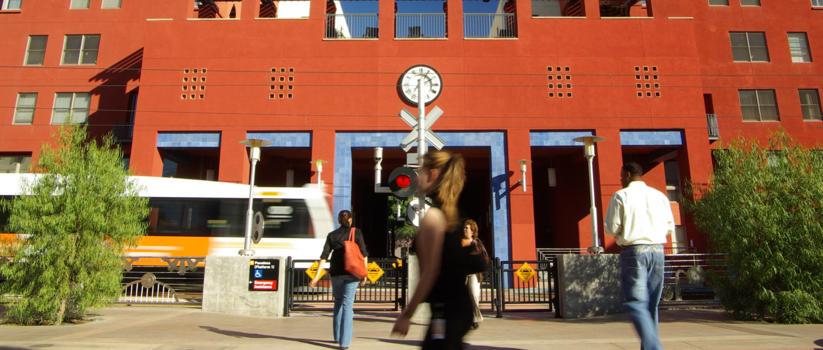
SCAQMD Rule 2202 & City Ordinance
AVR Survey Processing & Calculation
(No cost Employers)
Online Ridematching
(www.ridematch.info)
Personalized RideGuides
(100% Electronic)

Slide 9
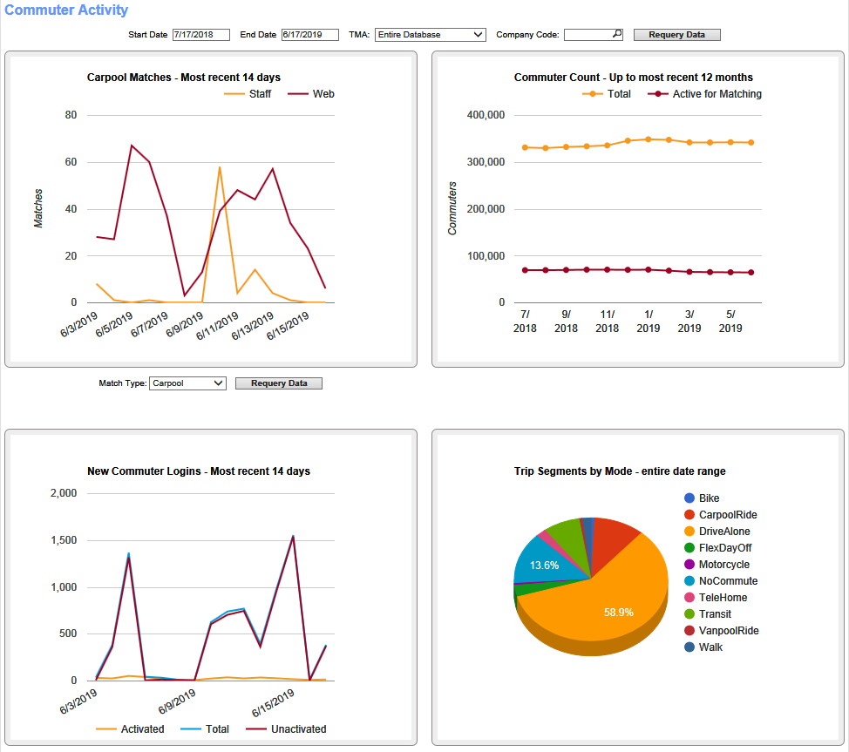
ETC Portal On-Line Access
Standard Dashboards
Provides a graphical view of commuter activity
Optional views available from the drop-down menus

Slide 10
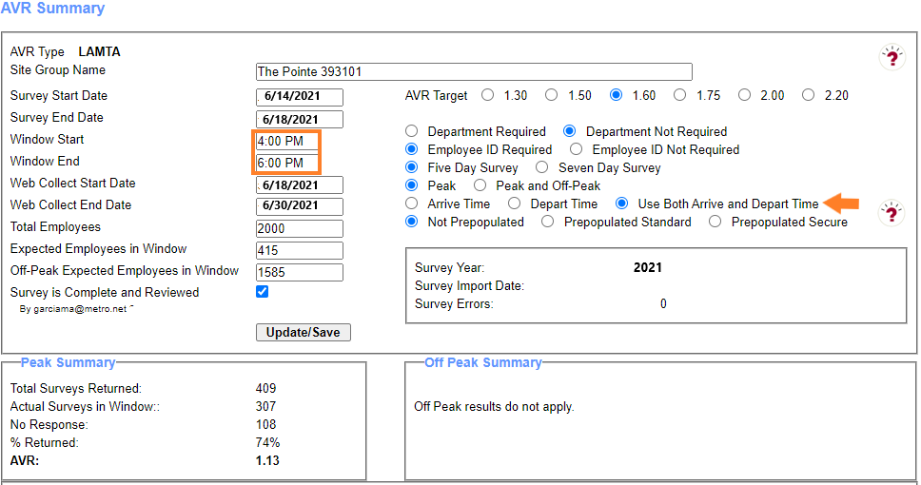
City of Burbank Ordinance
AVR results are compiled only for those employees that arrive and/or depart between 4-6PM
Employers with 25 or more employees in the Downtown Burbank and Media Districts are required to reduce the number of employee vehicular trips that their businesses
Monitor Your Real-Time AVR and Response Rate During Survey Process

Slide 11
AVR Calculations No Cost to Employers
Four (4) AVR survey options for employers:
Electronic/Online
Paper
Combination

Slide 12
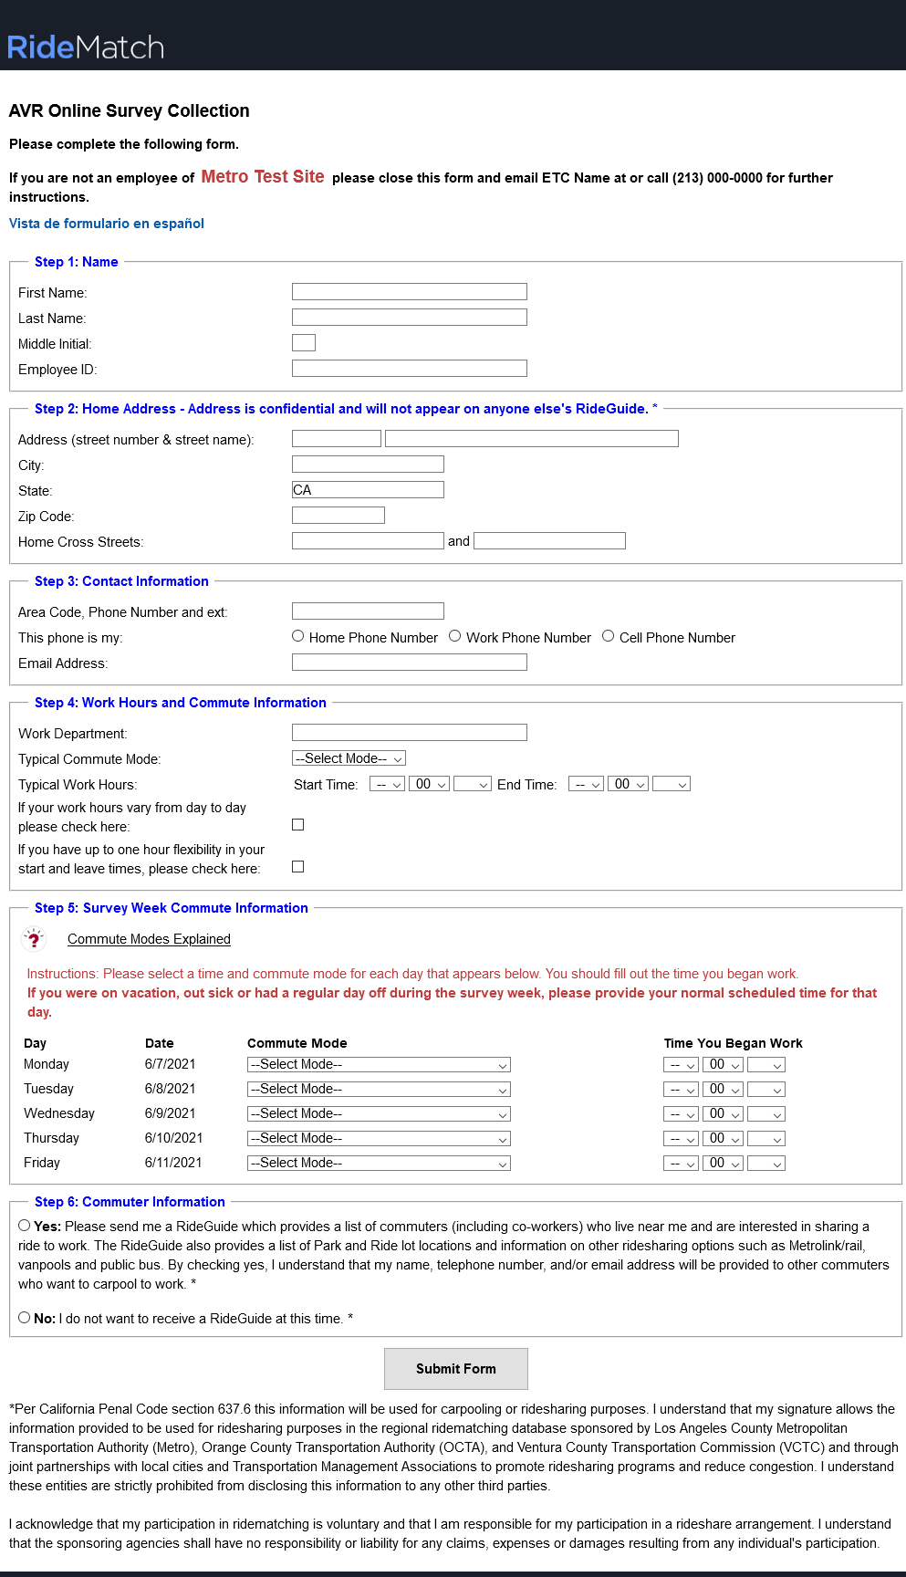
Electronic/Online
You will be sent an online link and QR code to send to your employees.
The survey is accessible in both English and Spanish
All required fields must be completed to submit the survey
Arrival & Departure times are required even for days off.

Slide 13
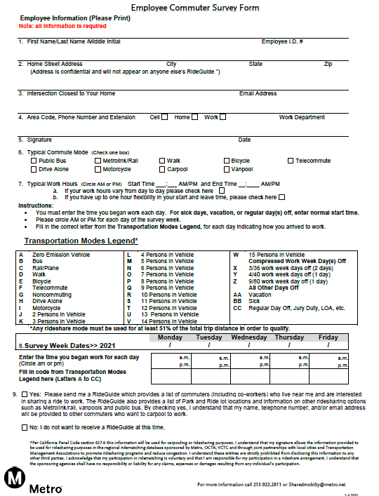
Paper Survey
If you use paper surveys, you will need to enter them in the system for automated calculation.
Forms must be signed by the employee.
Forms should be kept on file for 3 yrs after the survey period

Slide 14
Electronic/Online Required Fields
Step 1: Name
First Name, Last Name, Employee ID
Step 2: Home Address
Street Number, City, and Zip code or
Major cross streets, City, and Zip code
Step 3: Contact Information (Provide at least one)
Area code, Phone Number, and Email Address
Step 4: Work Hours and Commute Information
Typical Commute Mode, and Typical Work Hours
Step 5: Survey Form (Entire section must be completed)
Step 6: Commuter Information
Place a checkmark, Yes please send me a RideGuide
Place a checkmark, No I do not want to receive a RideGuide

Slide 15
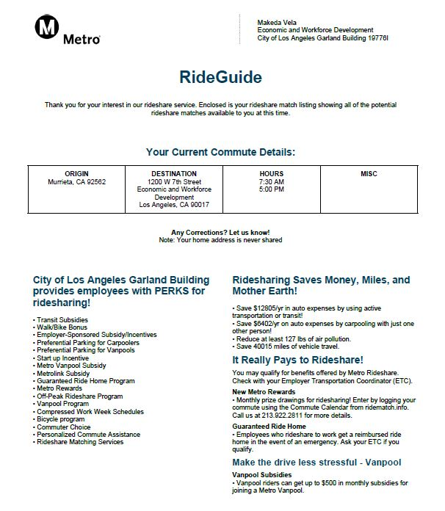
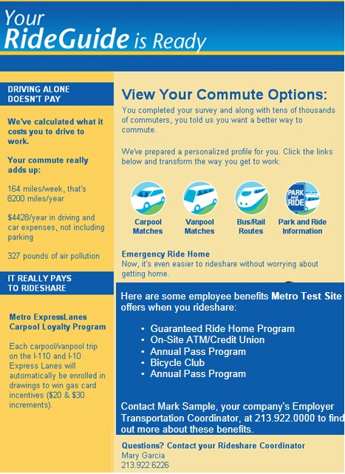
Say “YES” to a RideGuide
RideGuides may include potential carpool partners, vanpools, bus/rail routing, Park & Ride lot information and more.
To receive a RideGuide, employees must check “yes”
All employees that say “yes” to the RideGuide are entered into a monthly drawing for a $25 gift card. Flyer will be sent with the survey link and QR code.
Employees that want a RideGuide should fill the survey out in its entirety to find the best possible matches.
Personal information such as home address is never shared with others.

Slide 16
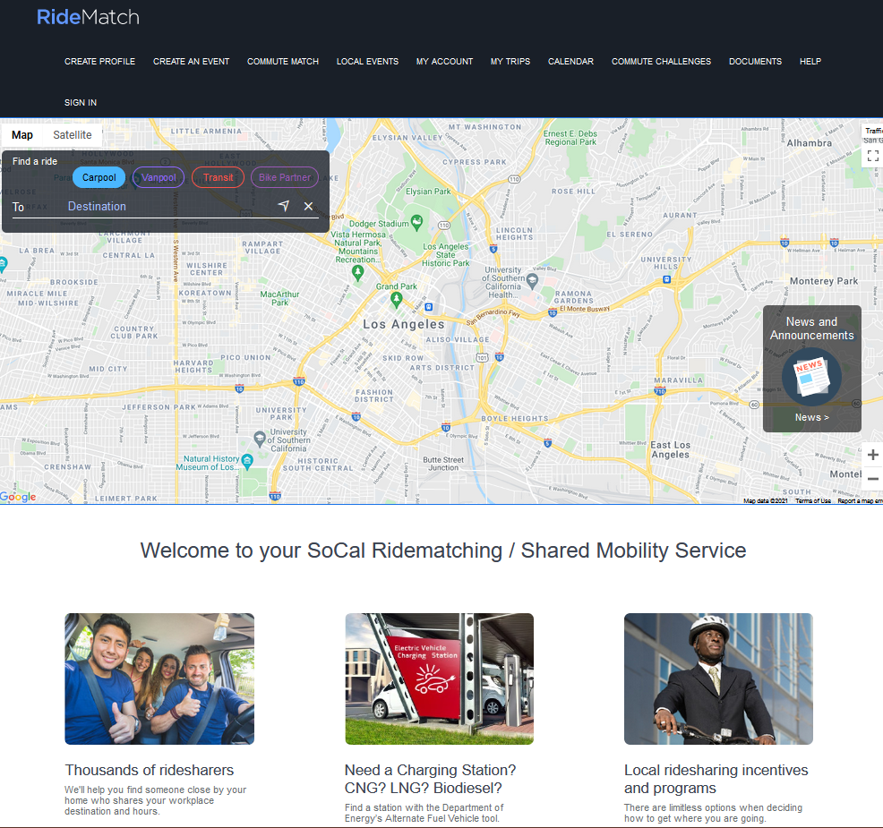
Ridematch.info Website
  Find carpool, vanpool, and bike partners
  Find transit routes and Park & Ride lots
  Match only with co-workers or other local employers
  Printing “RideGuide” is an option
  Find locations for Alternate Fuel and EV Charging Stations

Slide 17
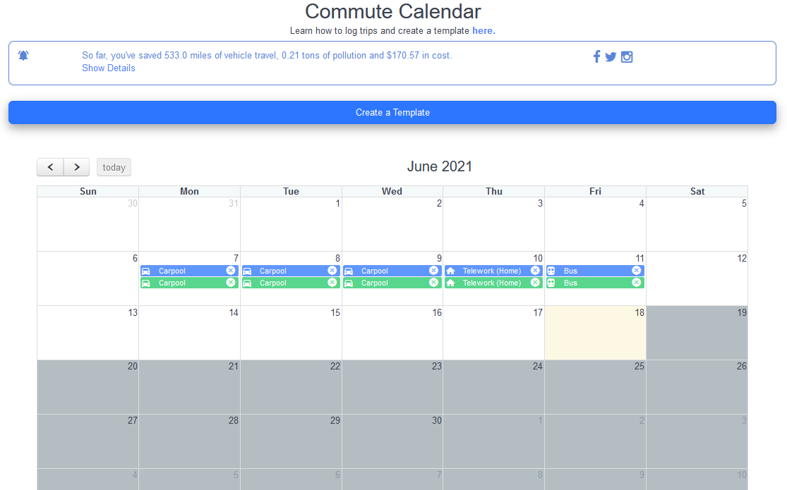


Metro Incentive Programs
Metro Rewards
Provides monthly prize drawings for employees who register and track their commute trips online at ridematch.info via computer or mobile device
Go Metro to Work Free
Provides a free 7-Day Metro TAP card, a $25 value, to newly hired employees at participating worksites

Slide 18
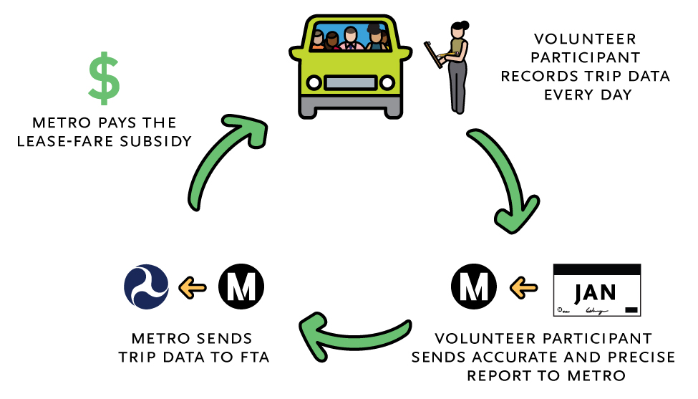
Metro Vanpool
Metro Vanpool provides up to $600 monthly lease subsidy towards the lease of vehicle.
Available to vanpools terminating their trip at a worksite in Los Angeles County
VOLUNTEER PARTICIPANT
COMPLETES AND SUBMITS
THE MONTHLY REPORTS ONLINE

Slide 19
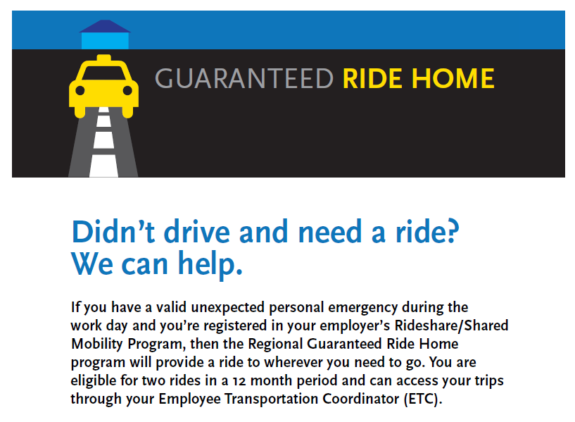
Regional Guaranteed Ride Home Program

Slide 20
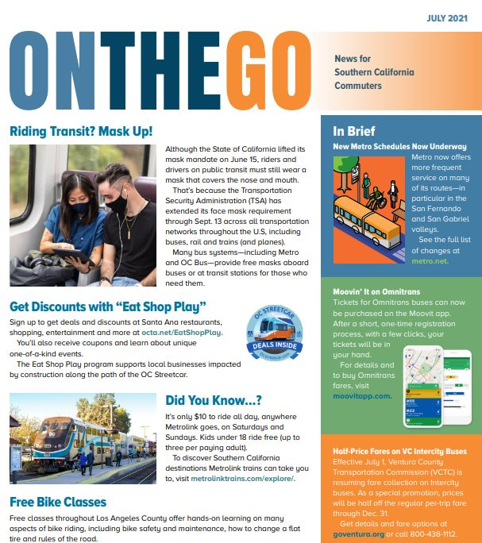
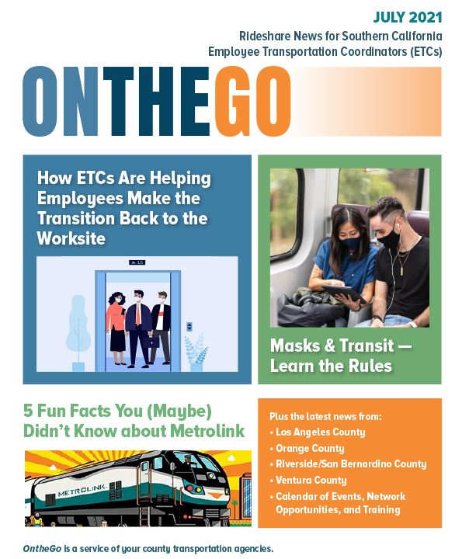
On the Go Newsletter
ETC Newsletter and Commuter Newsletter

Slide 21
QUESTIONS?
Tiffany Fischer
fischert@metro.net
(213) 922-4233
Commuter Options
commuteroptions@metro.net
(213) 922-2811

Slide 22
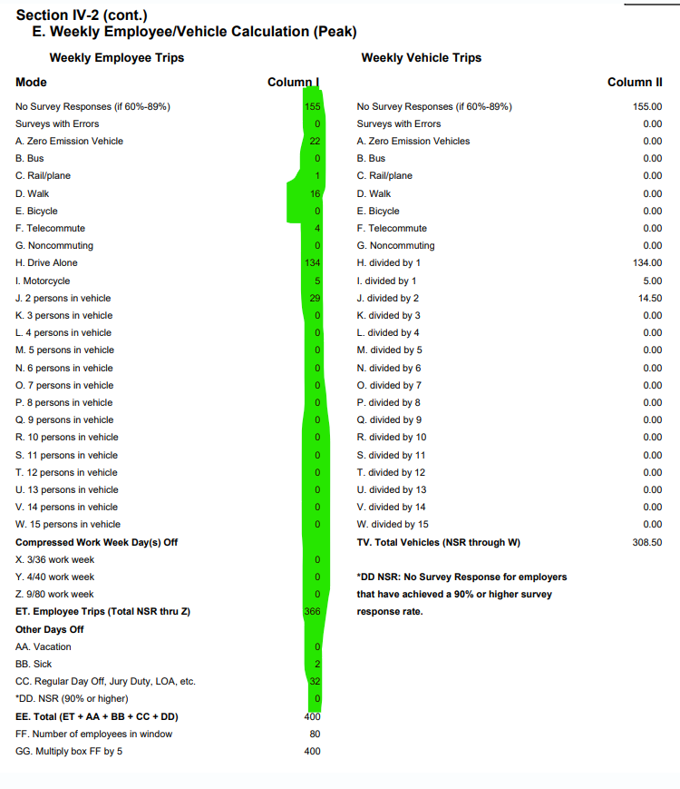
Option 1: TMO Trip Reduction Report (From LA Metro Tool)
Copy the numbers highlighted in green to the Form B cells in green.
Also fill ONLY the yellow highlighted sections manually.
After filling out the highlighted sections, the AVR will automatically calculate
Notes:
The excel file has a worksheet that let’s you tally up all of the trips. It’s called “Worksheet.” This helps ease the calculations needed to be done for the worksheet on the previous slide.

Slide 23
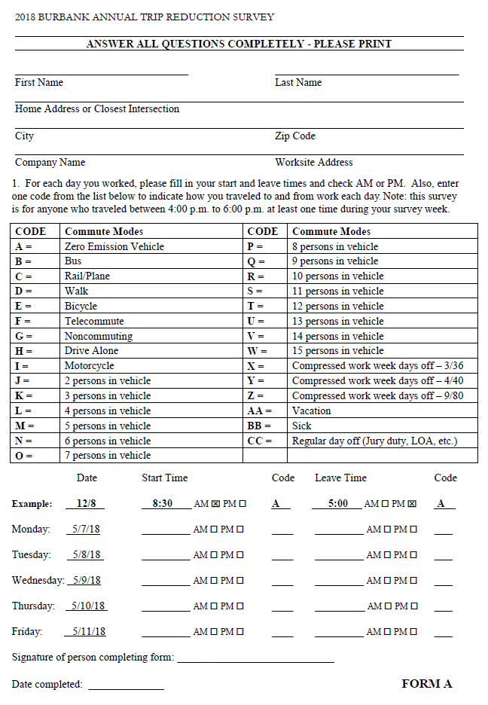
Option 2: TMO Trip Reduction Report (Manuel)
Notes:
This is the TMO’s trip reduction survey form.

Slide 24
Option 2: TMO Trip Reduction Report (Manuel)
Fill out ONLY the highlighted sections by tallying the results from the collection of Form As. Make sure to only include responses from peak period (4pm – 6pm)
After filling out the highlighted sections, the AVR will automatically calculate
Notes:
The excel file has a worksheet that let’s you tally up all of the trips. It’s called “Worksheet.” This helps ease the calculations needed to be done for the worksheet on the previous slide.

Slide 25
Contact the BTMO at:
(213) 425-0976
director@btmo.org
Learn more at:
https://btmo.org/survey-support/
Follow us on:
@TheBTMO on Facebook, Instagram, and Twitter
Questions?

